Slide 1
SX Sustainability academy
Building a Bright Future: An Intro to Solar Energy (secondary)

Slide 2

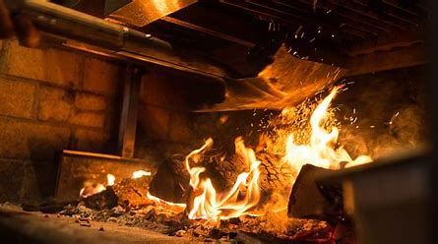



Imagining a world without electricity

Slide 3
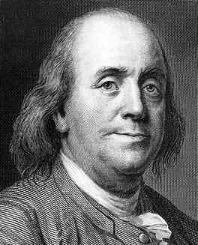
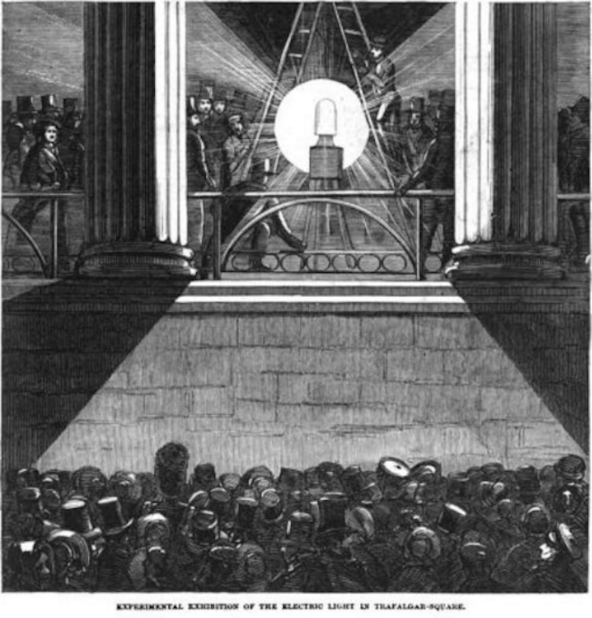

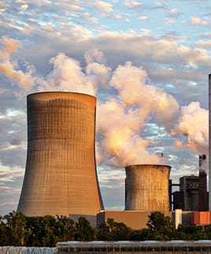
What is electricity?
Electricity is a big part of our lives, and sometimes we don’t even realize it. First, let’s take a look at what electricity is.

Slide 4
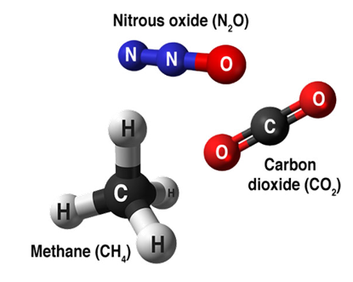


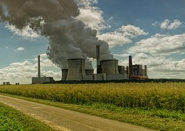
GHg’s and electricity
> Since the industrial revolution, human activities have extracted huge amounts of gas, oil and coal from the ground to burn them to create energy.
This releases large amounts of CO₂, CH₄ and N₂O into the atmosphere.
The concentration of these gases has increased, leading to additional greenhouse effect: this is what causes global warming.
N2O
CO2
Coal power plant

Slide 5
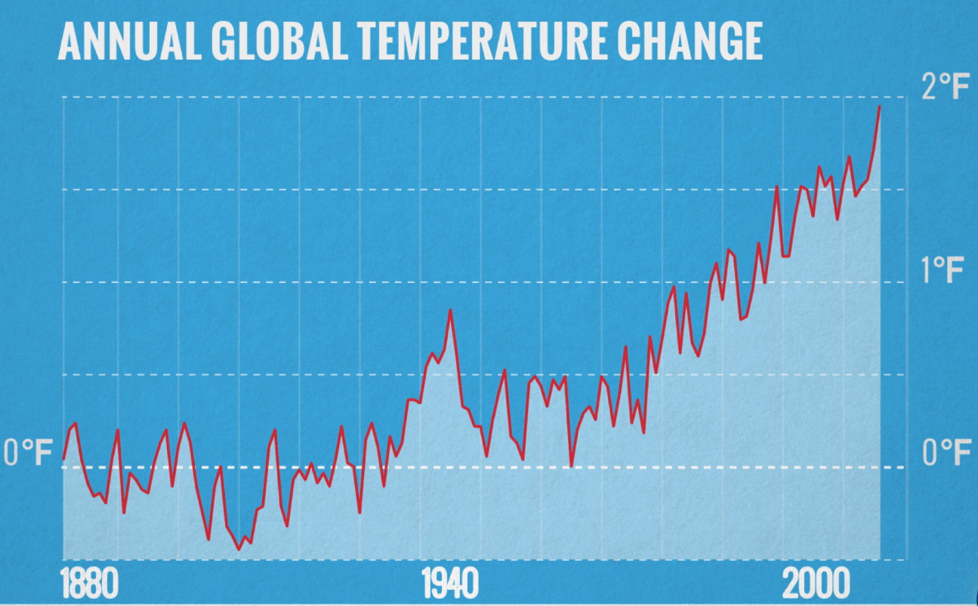
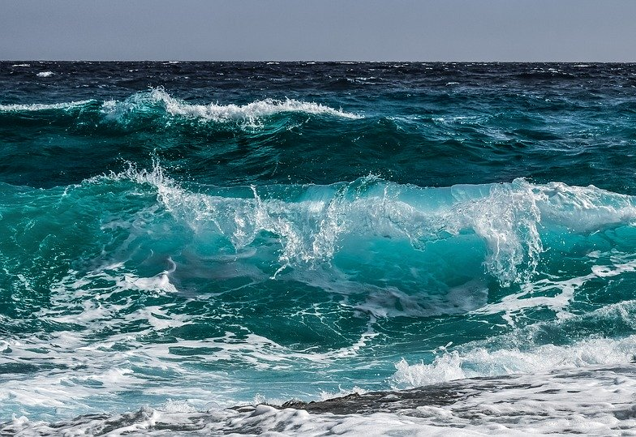
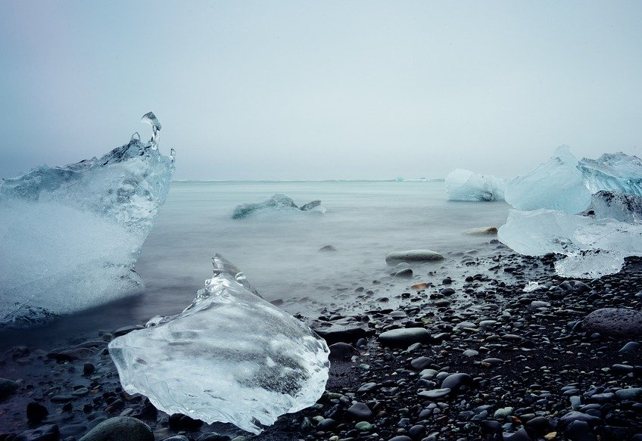
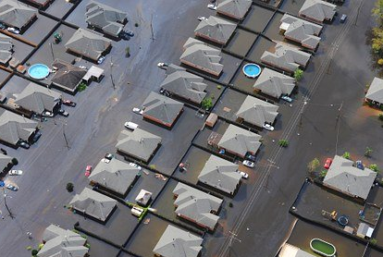

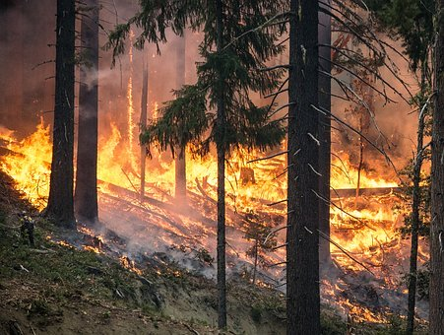
What is climate change?
The Earth’s climate has changed throughout history.
Within the Earth’s history, there have been numerous examples of a changing climate.
The beginning of the modern climate era began 11,700 years ago with the end of the last ice age.
So why is current climate change an issue?
The current climate change is of particular significance because it is extremely likely to be the result of human activity and is occurring at a much faster rate.
https://climate.nasa.gov/

Slide 6






Solving the problem
The role of renewable energy
We can produce electricity through two main sources… Renewable and non-renewable sources!
Non-renewable energy comes from resources that are not replaced, or are replaced only very slowly by natural processes.
Renewable energy is energy from sources that are naturally replenishing.
This is what we do!

Slide 7
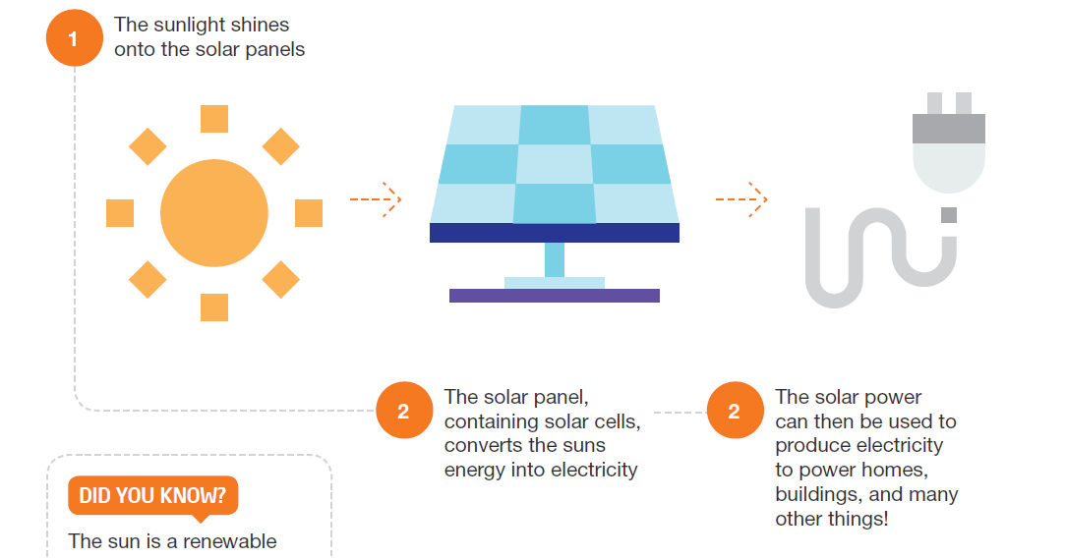
What is solar energy?
The photovoltaic effect was explained by Einstein, which earned him the 1921 Nobel Prize in Physics. It converts the photon energy in light into electricity (via electrons).
Solar PV panels are usually made of silicon, which is nothing more than purified sand!

Slide 8
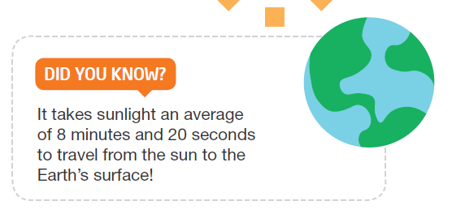
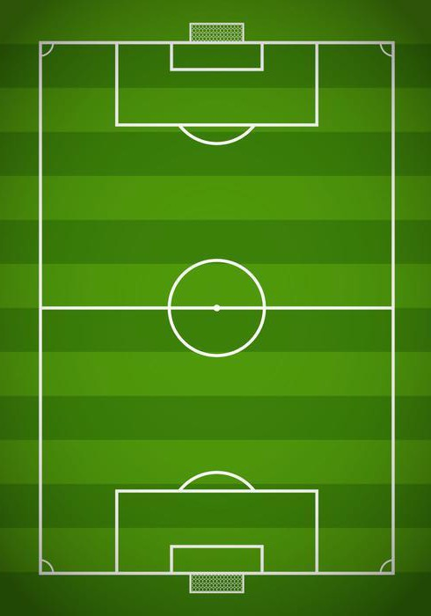




1MW of solar pv…
POWER
~200
1 hectare
HOMES
per year*
Avoids an average
1,000
metric tons
of CO₂ emissions
per year
1MW of solar PV is the equivalent of one football pitch!
* According to USA energy data

Slide 9
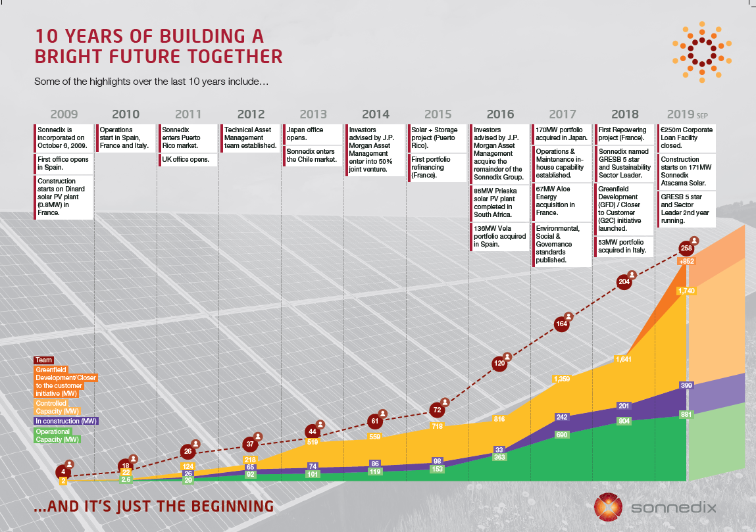
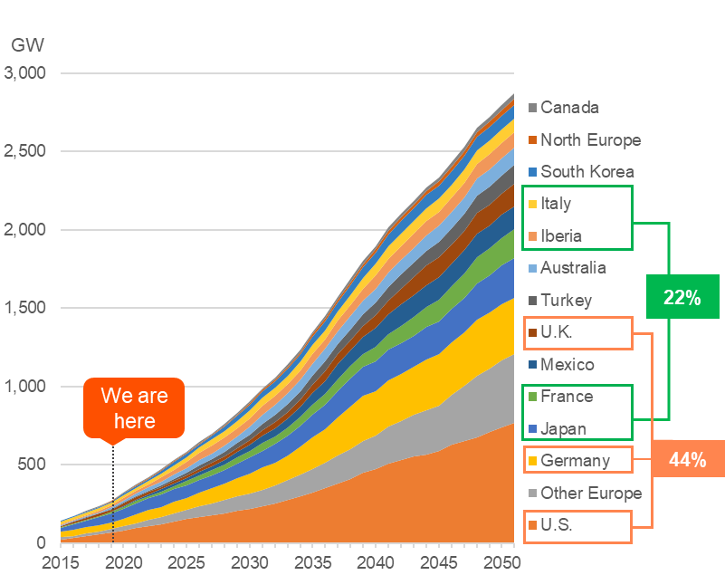
Solar is at a tipping point
OECD CUMULATIVE INSTALLED SOLAR CAPACITY BY COUNTRY/ REGION

Slide 10
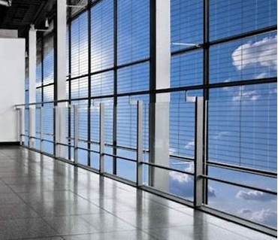
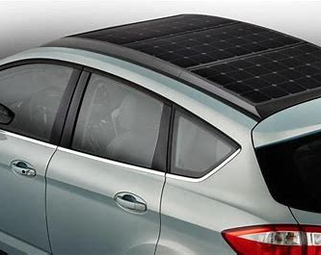
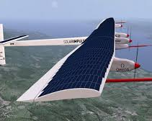
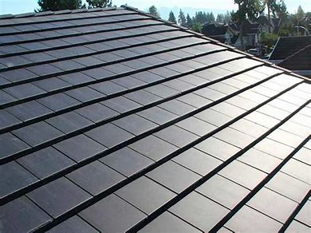
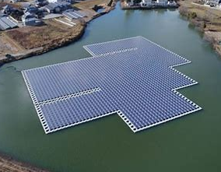
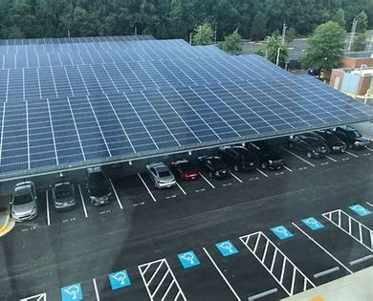
The future?

Slide 11


Our vision is to build a bright future!
What´s yours?
Our pledge:
We urge everyone to become leaders in climate change, to spread the word, and to be a part of the climate solution.

Slide 12
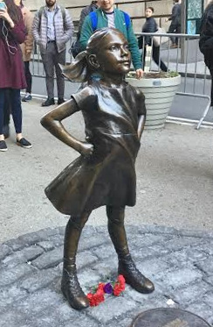
ACTIVITY: Make a pledge!
Email your pledge to Sonnedix at esg@sonnedix.com

Slide 13

Thank you for playing your part to fight climate change!
Do you want to know more? If so, find more resources about climate change, solar and other topics related to sustainable development at Sonnedix Sustainability Academy:
https://www.sonnedix.com/sustainability-academy

