Slide 1
SX Sustainability academy
Building a Bright Future: An Intro to Solar Energy (Primary)

Slide 2

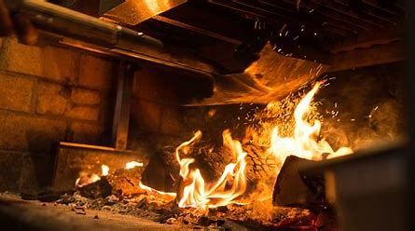
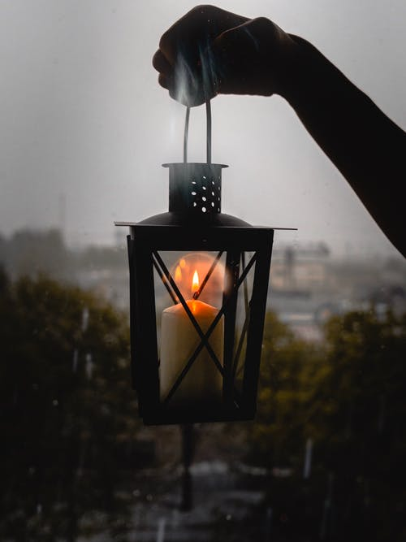


Imagining a world without electricity

Slide 3
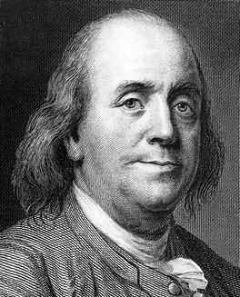
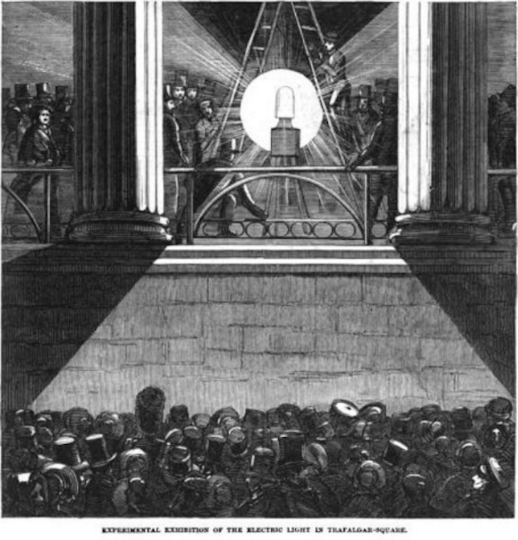

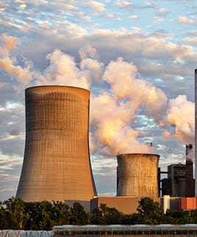
What is electricity?
Electricity is a big part of our lives, and sometimes we don’t even realize it. First, let’s take a look at what electricity is.

Slide 4

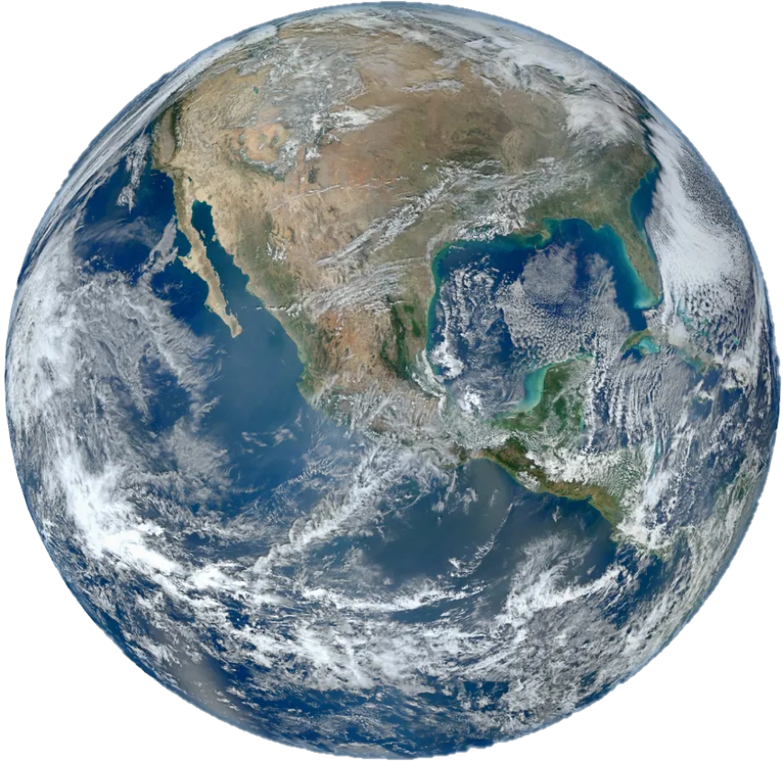
Where does electricity come from?

Slide 5
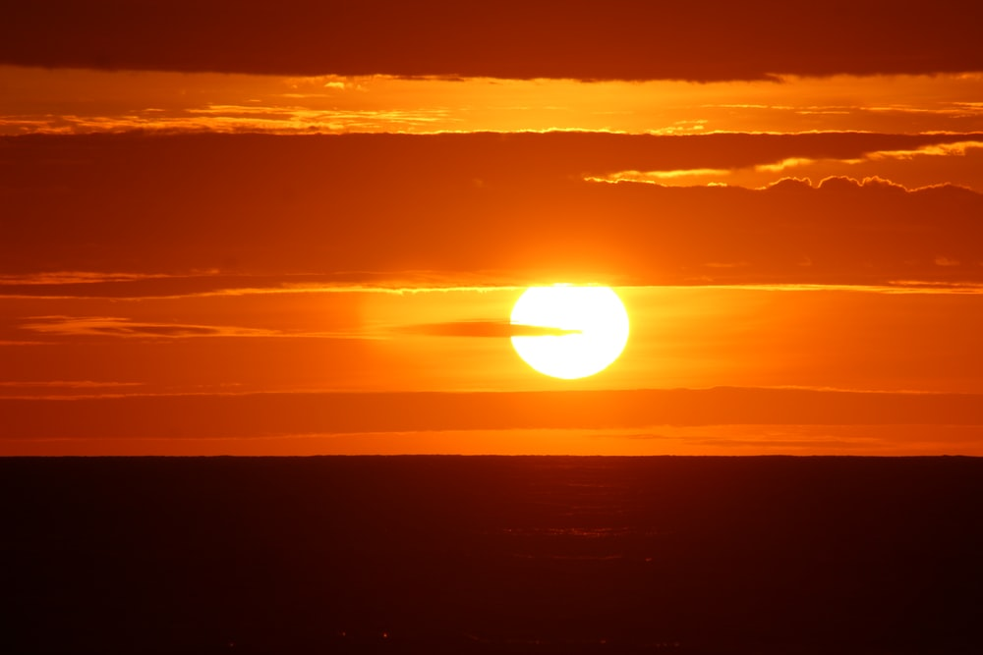
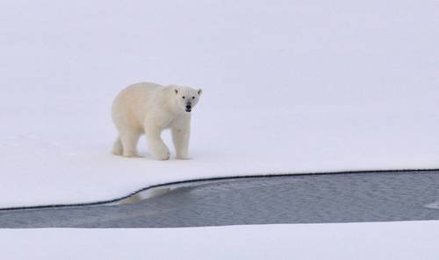


WHAT IS CLIMATE CHANGE?

Slide 6
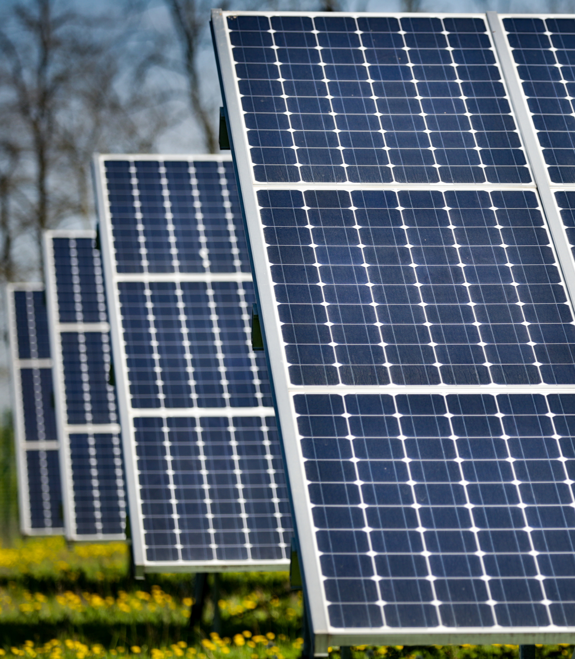

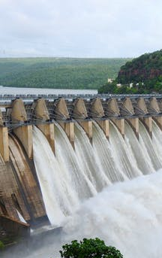
What can we do about it? Solar energy!
We need electricity, but producing it can be harmful to the planet.
How else can we produce electricity?
SOLAR (this is what we do!)
WIND
WATER

Slide 7
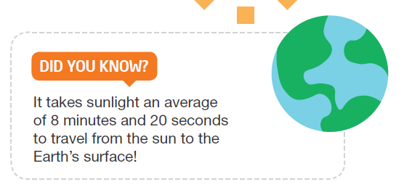
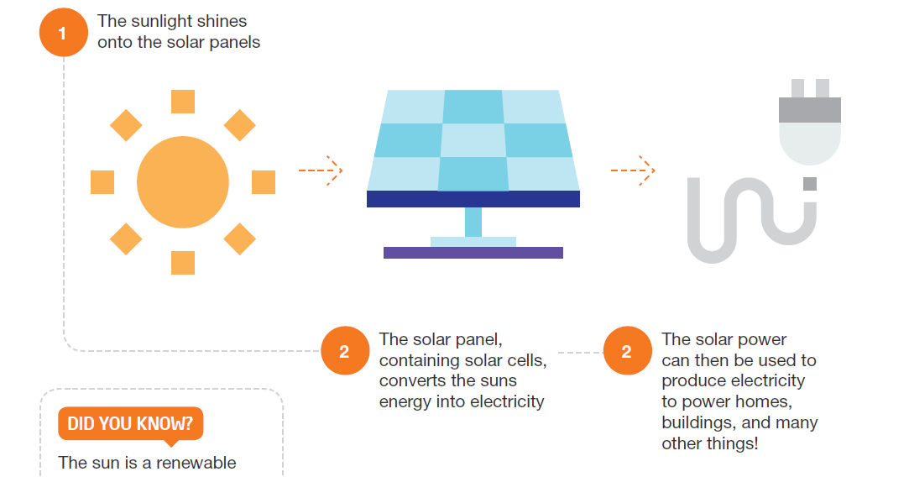
What is solar energy?

Slide 8
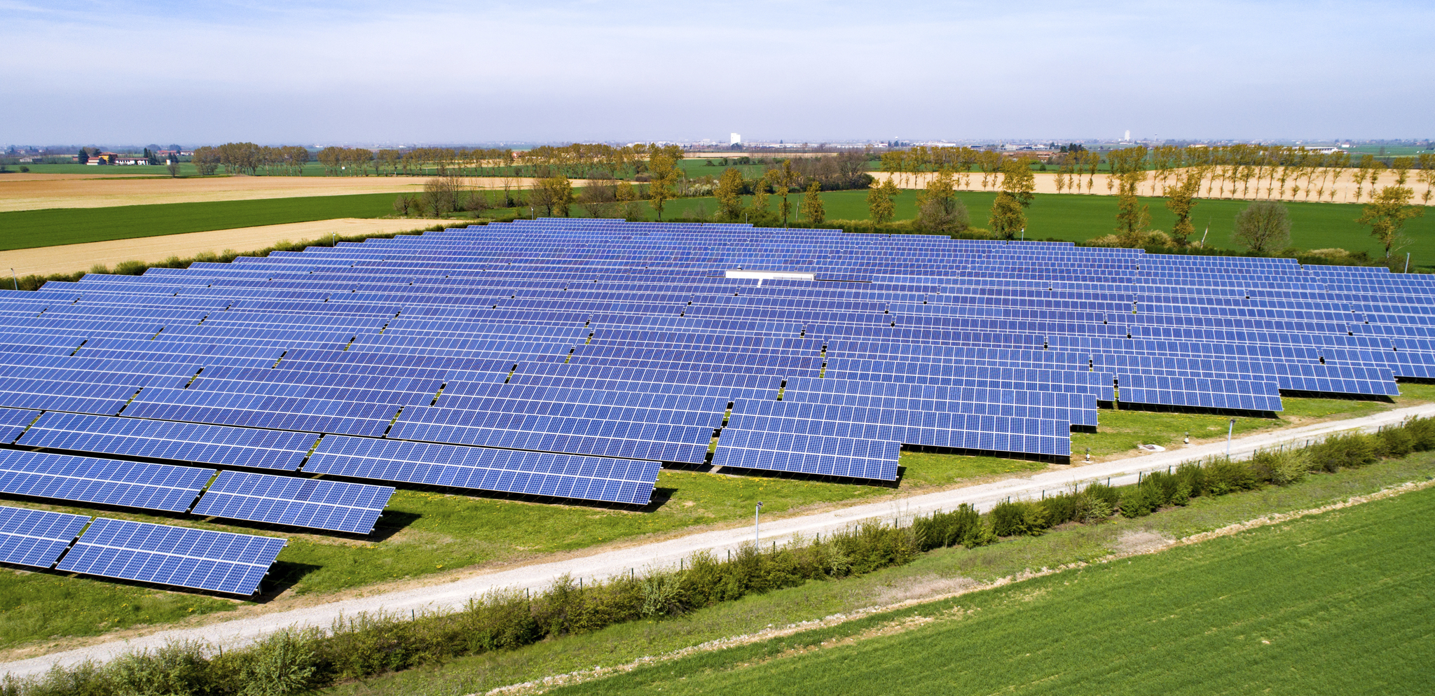




Why do we need solar energy?
For climate change!
Less impact on animals!
Less pollution!
The sun won’t run out!

Slide 9
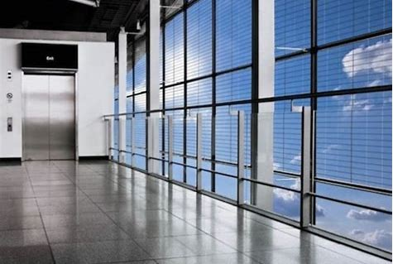
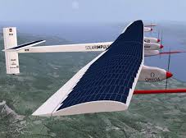
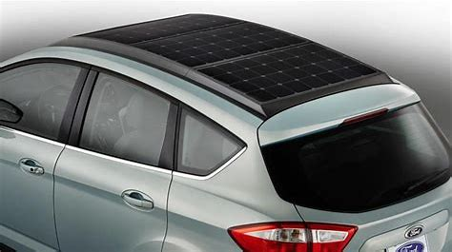
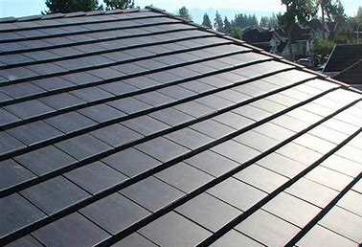
The future?

Slide 10


Our vision is to build a bright future!
What´s yours?
Our pledge:
We urge everyone to become leaders in climate change, to spread the word, and to be a part of the climate solution.

Slide 11
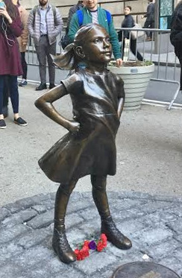
ACTIVITY: Make a pledge!
Email your pledge to me at esg@sonnedix.com
Notes:
Climate activism starts now, give some ideas of what pledges can be made.

Slide 12

Thank you for playing your part to fight climate change!
Do you want to know more? If so, find more resources about climate change, solar and other topics related to sustainable development at Sonnedix Sustainability Academy:
https://www.sonnedix.com/sustainability-academy

