Slide 1
SX Sustainability academy
Climate Change
Age 9-13

Slide 2
thinking about climate change
Have you heard of climate change?

Slide 3
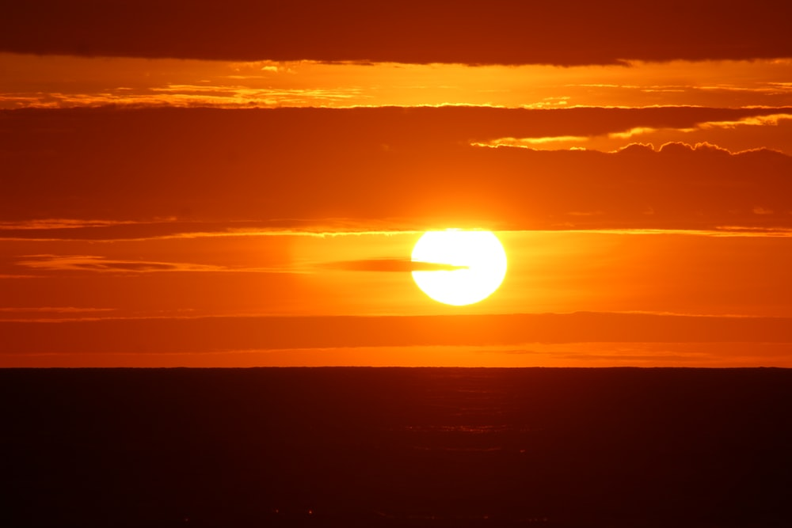
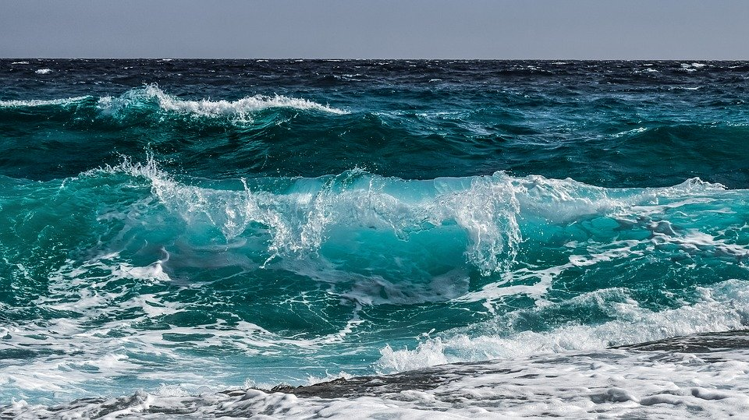
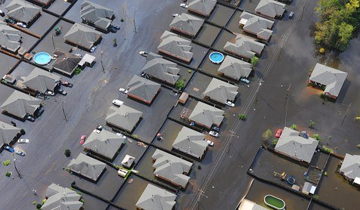
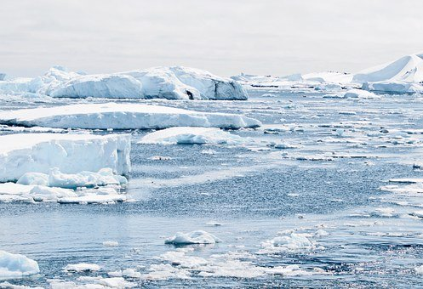
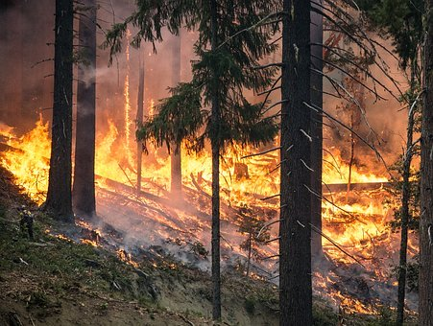
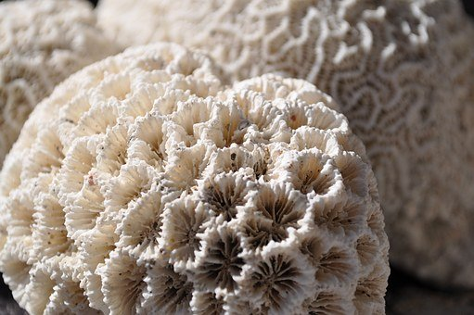
WHAT IS CLIMATE CHANGE?
The evidence

Slide 4
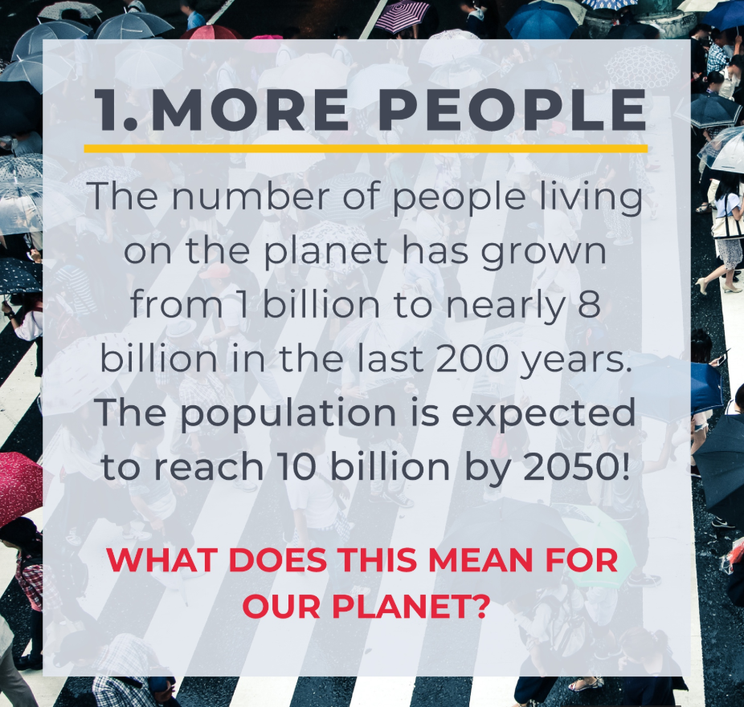
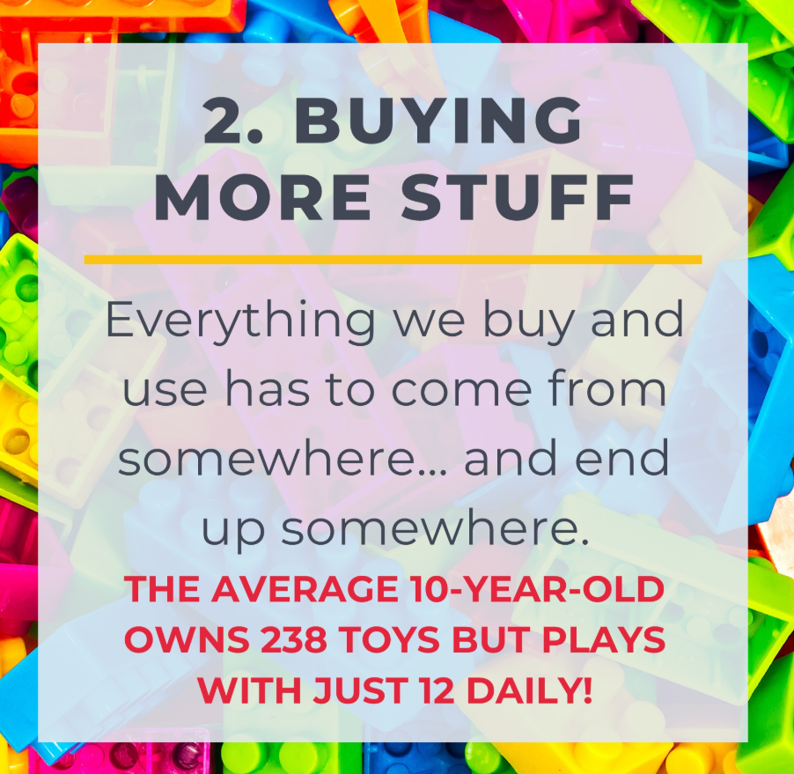
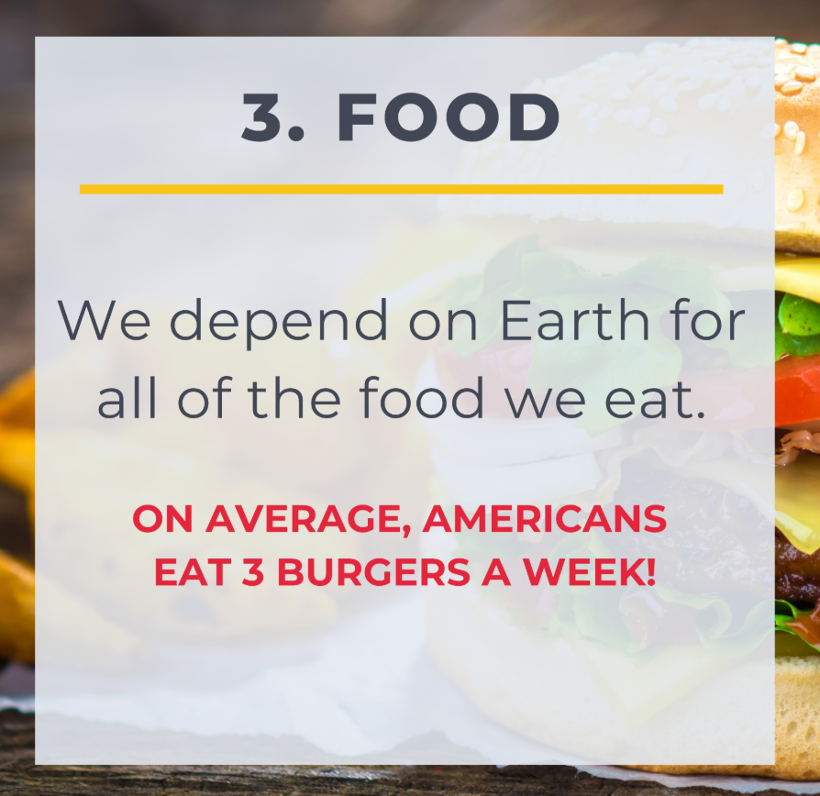
What’s leading to this?
This leads to an increase in harmful gases into our atmosphere… these are called Greenhouse Gases!

Slide 5




Where do THESE HARMFUL GASES come from?
1
2
3
4
.
.
.
.
From creating electricity!
From cutting down trees!
From cows!
From throwing away rubbish!

Slide 6
WHAT WILL THE WORLD LOOK LIKE IF CLIMATE CHANGE CONTINUES?
Let’s discuss!

Slide 7

What is a carbon footprint?
Your carbon footprint!
We may not realise it, but we ALL emit carbon dioxide through our day-to-day activities.
Your carbon footprint measures your individual impact on the planet based on the amount of carbon dioxide you emit.
By making different decisions, we can increase or decrease our carbon footprint.
The most common emitters than we can help to reduce are:

Slide 8
ACTIVITY: THINKING ABOUT YOUR FOOTPRINT!

Slide 9






Solving the problem
The role of renewable energy
Non-renewable energy comes from resources that are not replaced, or are replaced only very slowly by natural processes.
Renewable energy is energy from sources that are naturally replenishing.

Slide 10

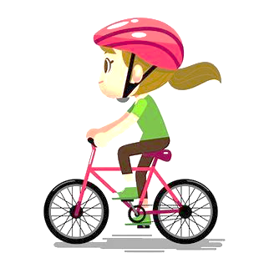

What can you do?
Protect the planet
1
2
3
.
.
.
Use less electricity or a different type!
Use the car less!
Eat less meat!

Slide 11
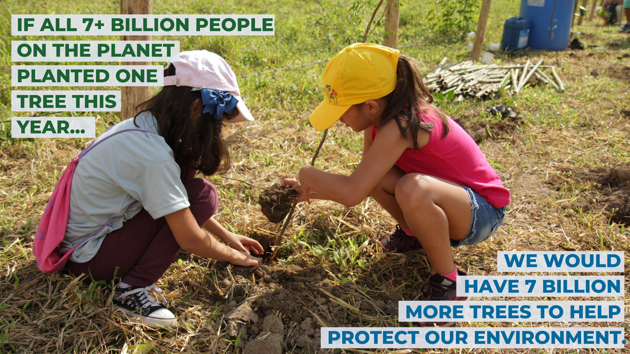
We can plant trees

Slide 12
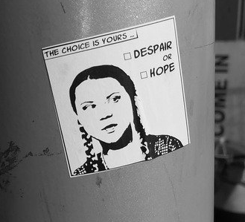
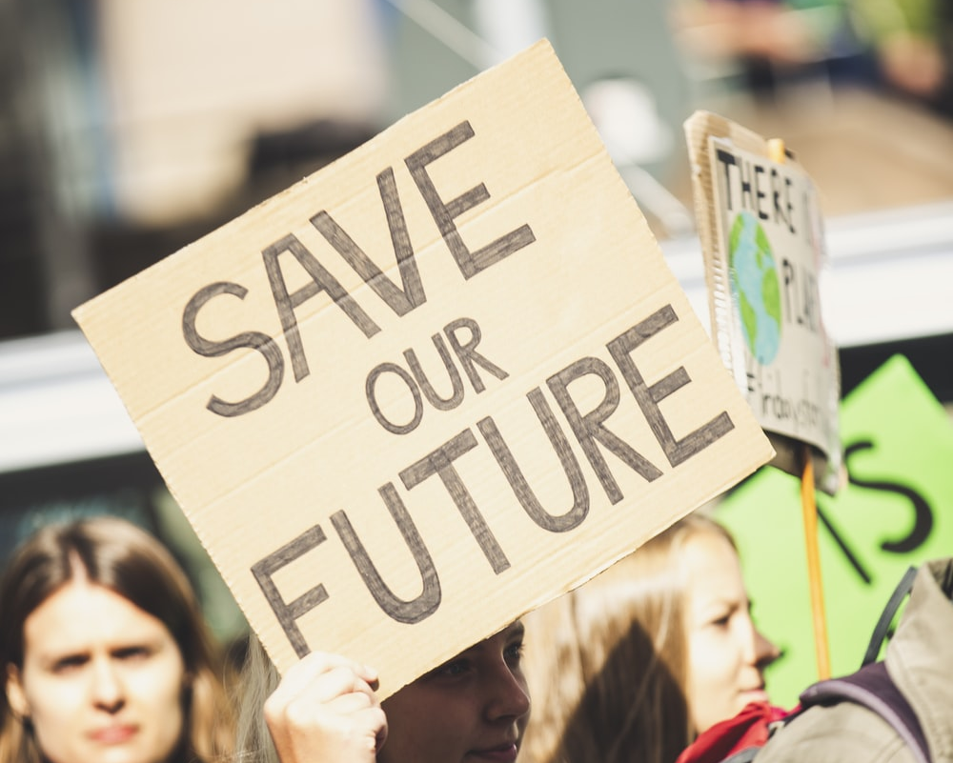
TALK ABOUT CLIMATE CHANGE
Speak up and inspire others to make a change

Slide 13
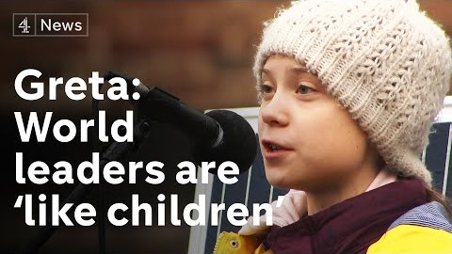

Slide 14
ACTIVITY: Make a pledge!

