Slide 1
SX Sustainability academy
Climate Change (Age 5-8)

Slide 2
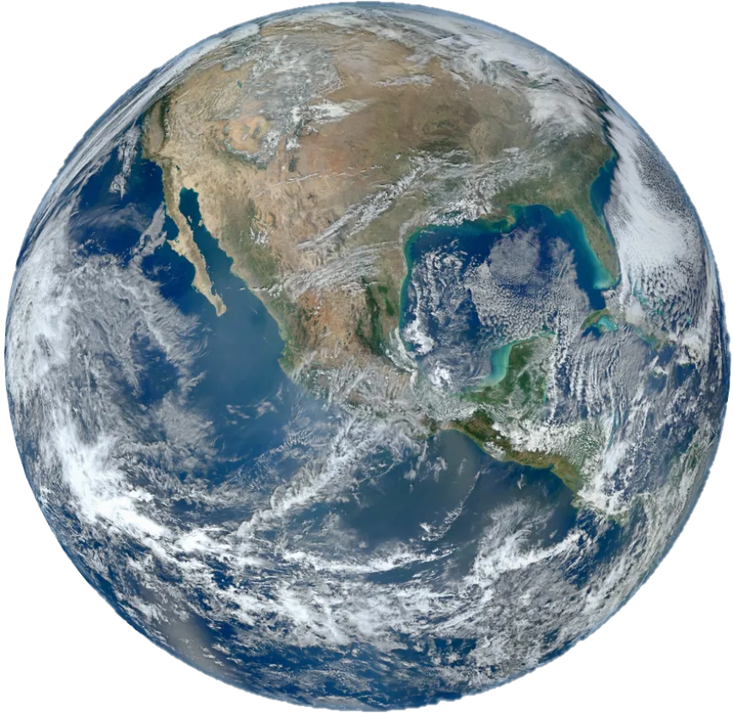
But our earth is changing

Slide 3

But our earth is changing

Slide 4
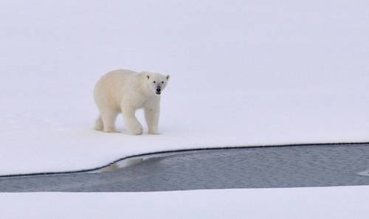
What does climate change look like?
The Arctic

Slide 5
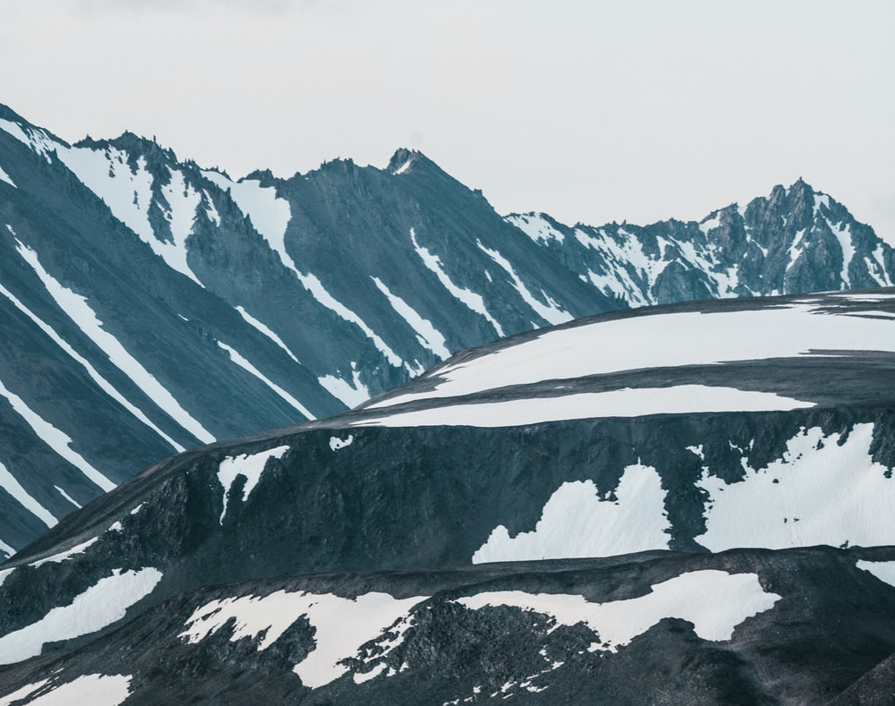
What does climate change look like?
The Arctic

Slide 6
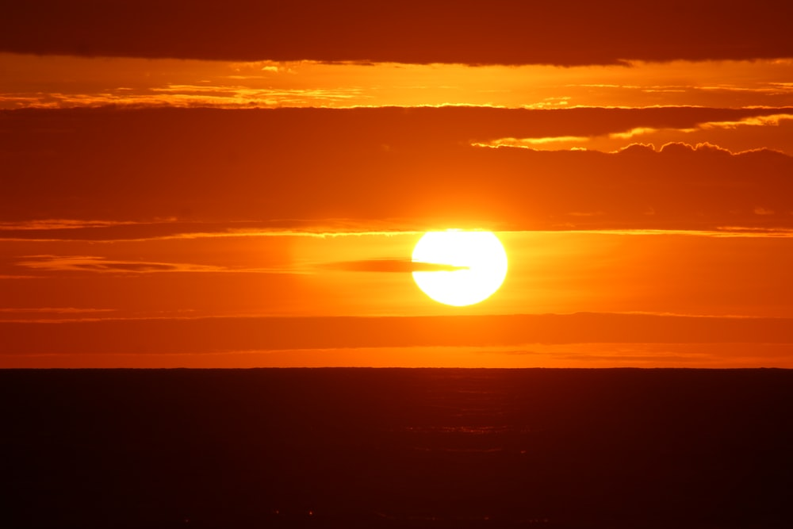
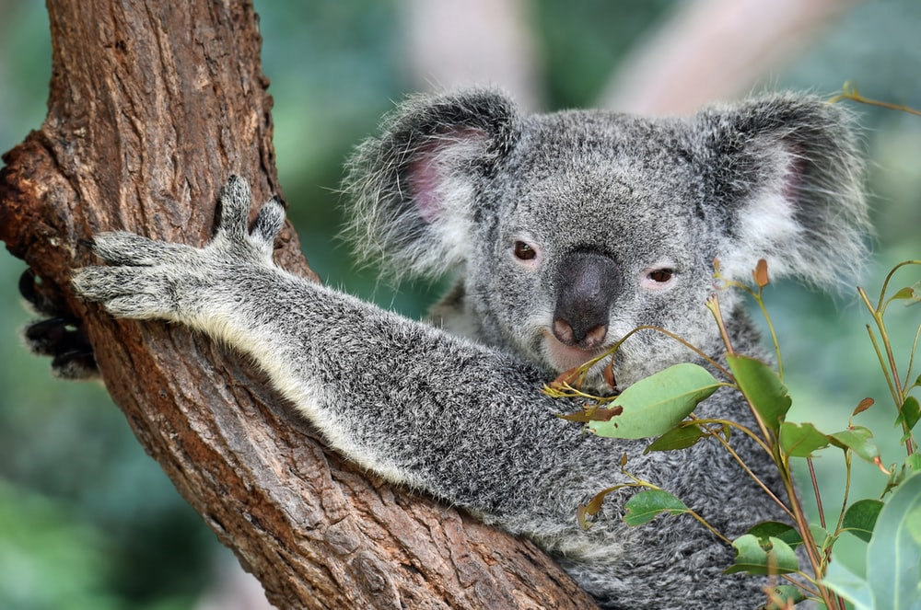
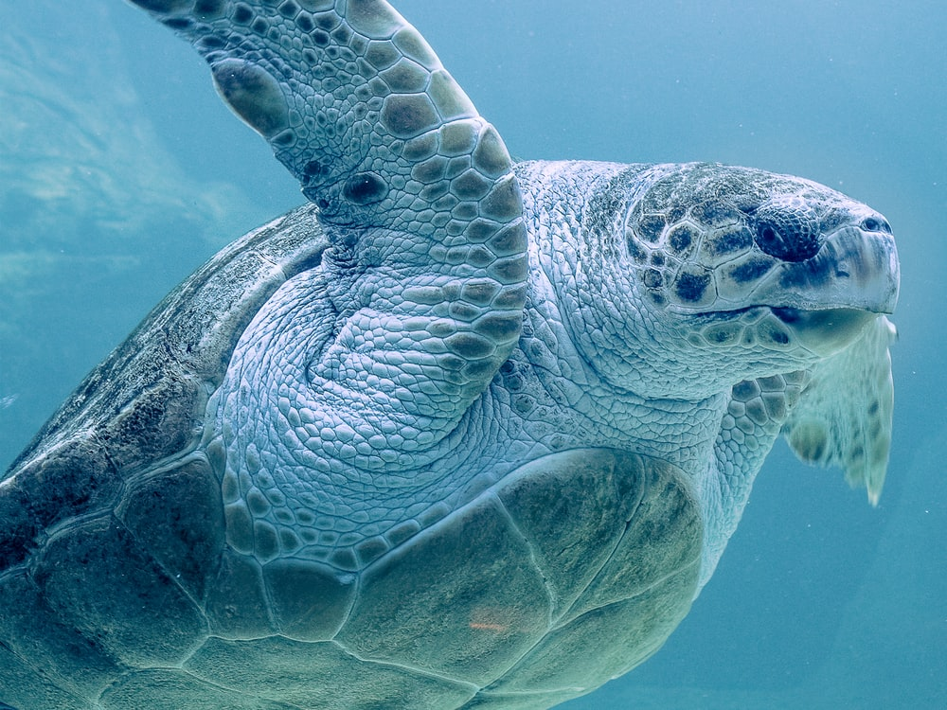
WHAT IS CLIMATE CHANGE?

Slide 7
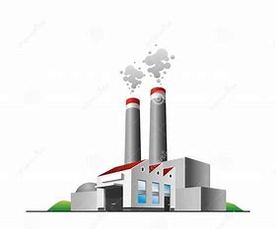

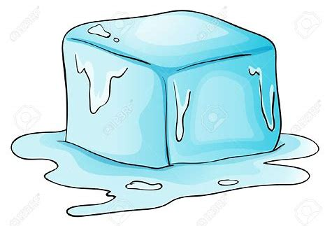
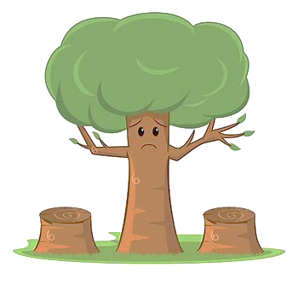
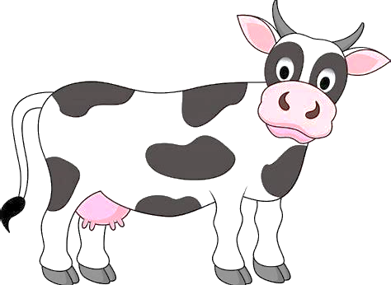
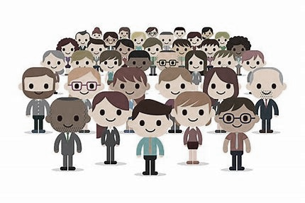
Whats causing this?

Slide 8
ACTIVITY: What can we do?

Slide 9
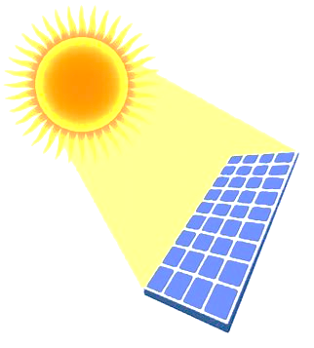
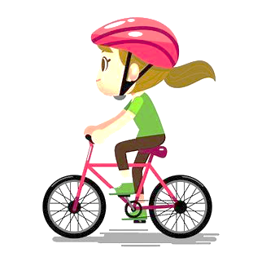

What can you do?
Protect the planet
1
2
3
.
.
.
Use less electricity or a different type!
Use the car less!
Eat less meat!

Slide 10
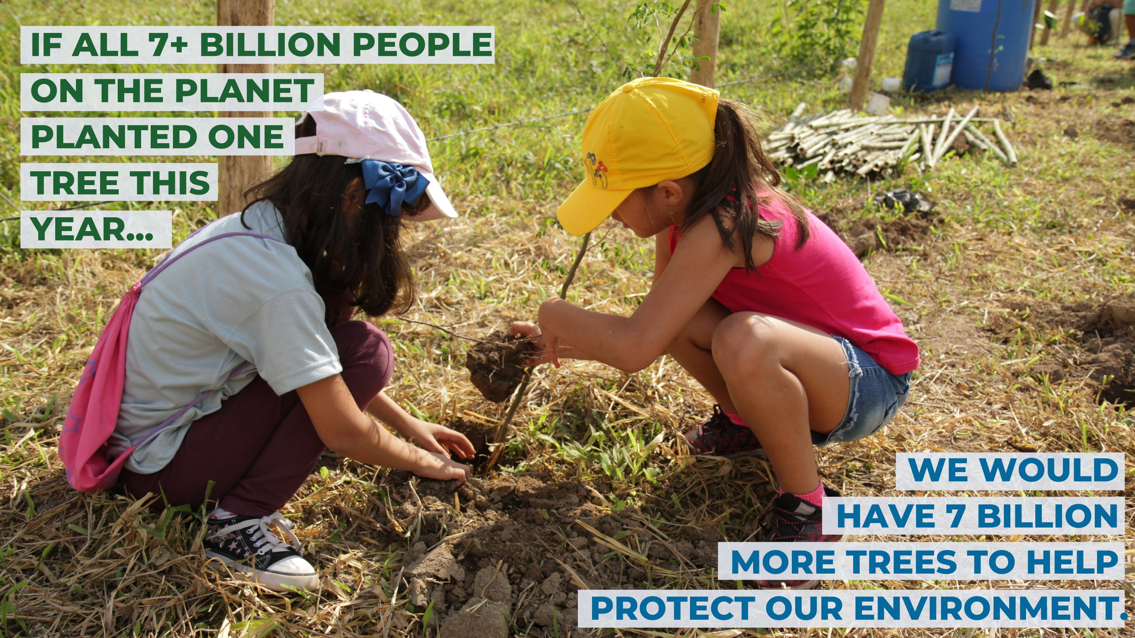
We can plant trees

Slide 11
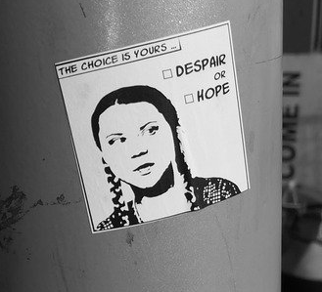
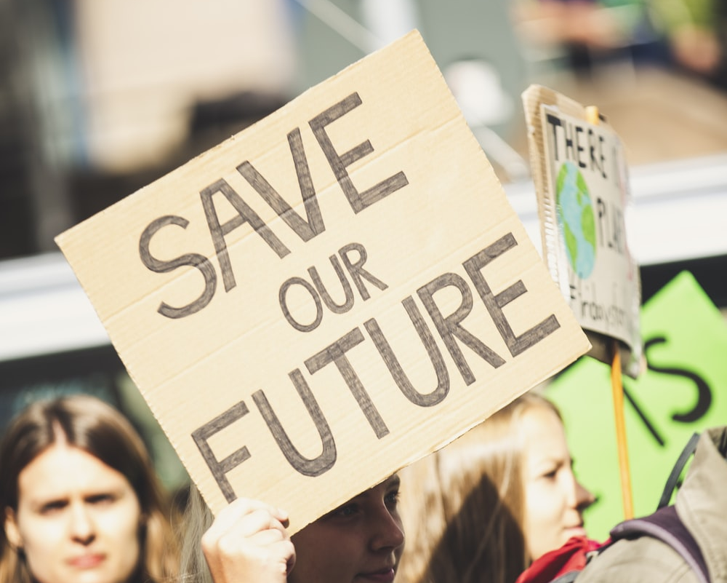
TALK ABOUT CLIMATE CHANGE
Speak up and inspire others to make a change

Slide 12
ACTIVITY: Make a pledge!

