Slide 1
SX Sustainability academy
Climate Change
Age 14-16

Slide 2
thinking about climate change
Have you heard of climate change?

Slide 3
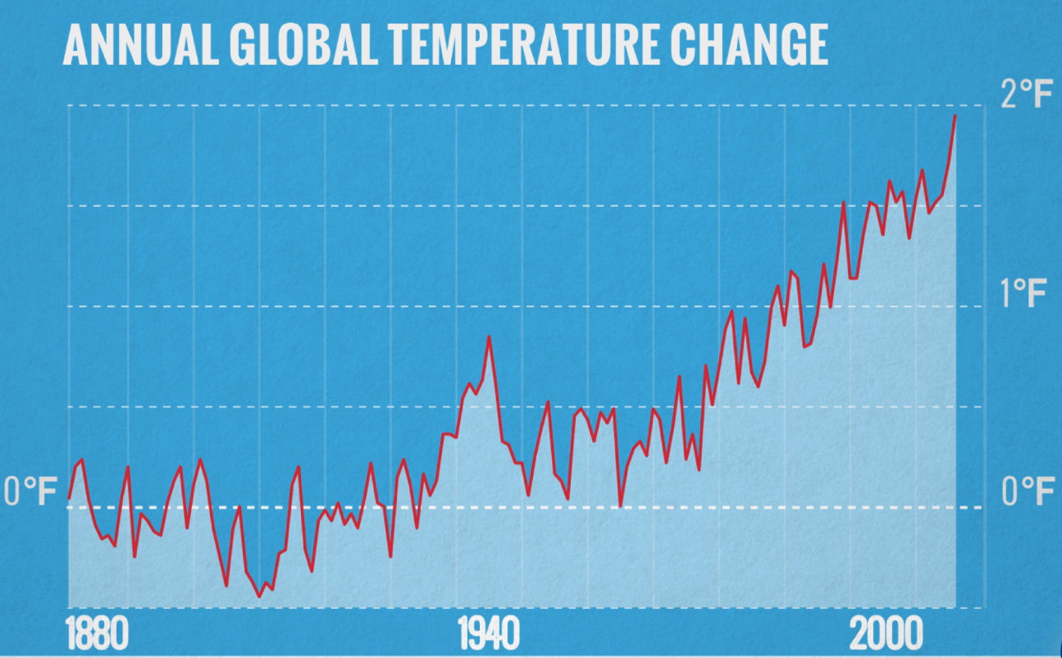
What is climate change?
The Earth’s climate has changed throughout history.
Within the Earth’s history, there have been numerous examples of a changing climate.
The beginning of the modern climate era began 11,700 years ago with the end of the last ice age.
So why is current climate change an issue?
The current climate change is of particular significance because it is extremely likely to be the result of human activity and is occurring at a much faster rate.
https://climate.nasa.gov/

Slide 4
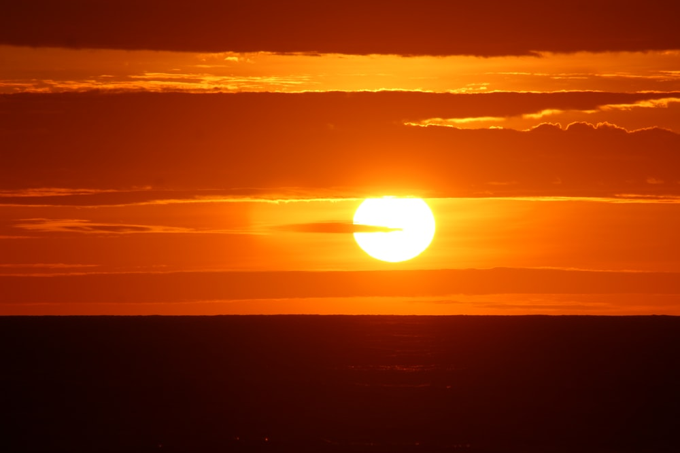
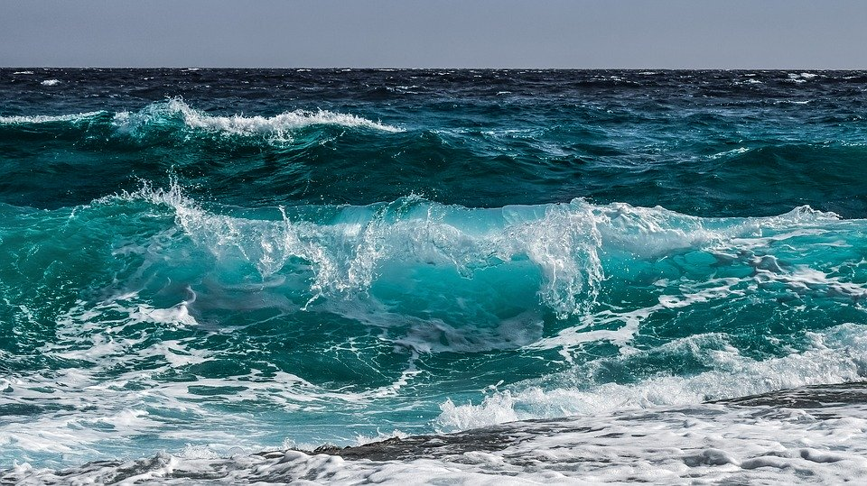
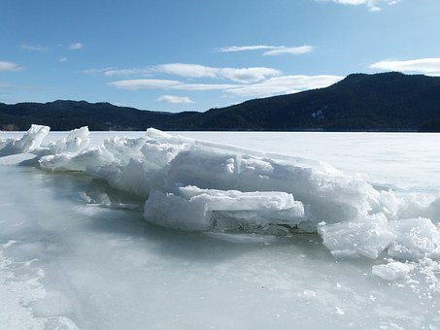
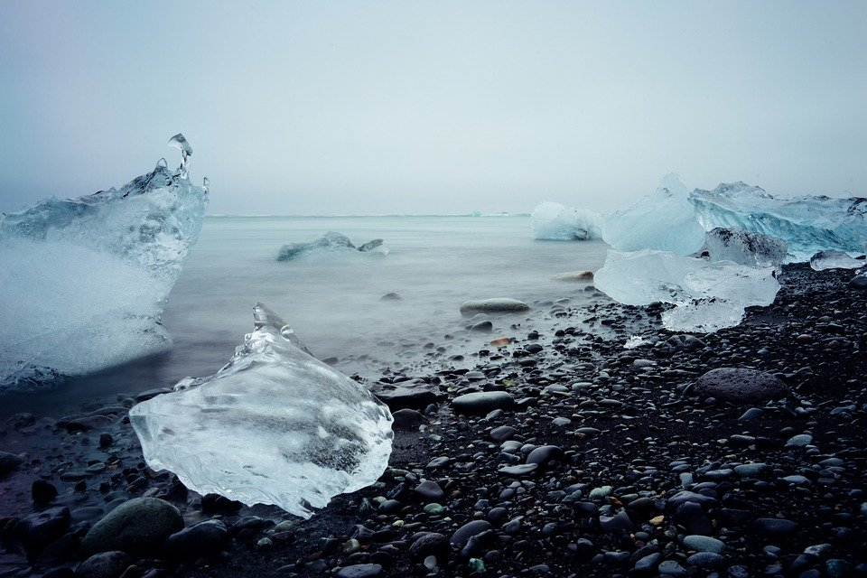
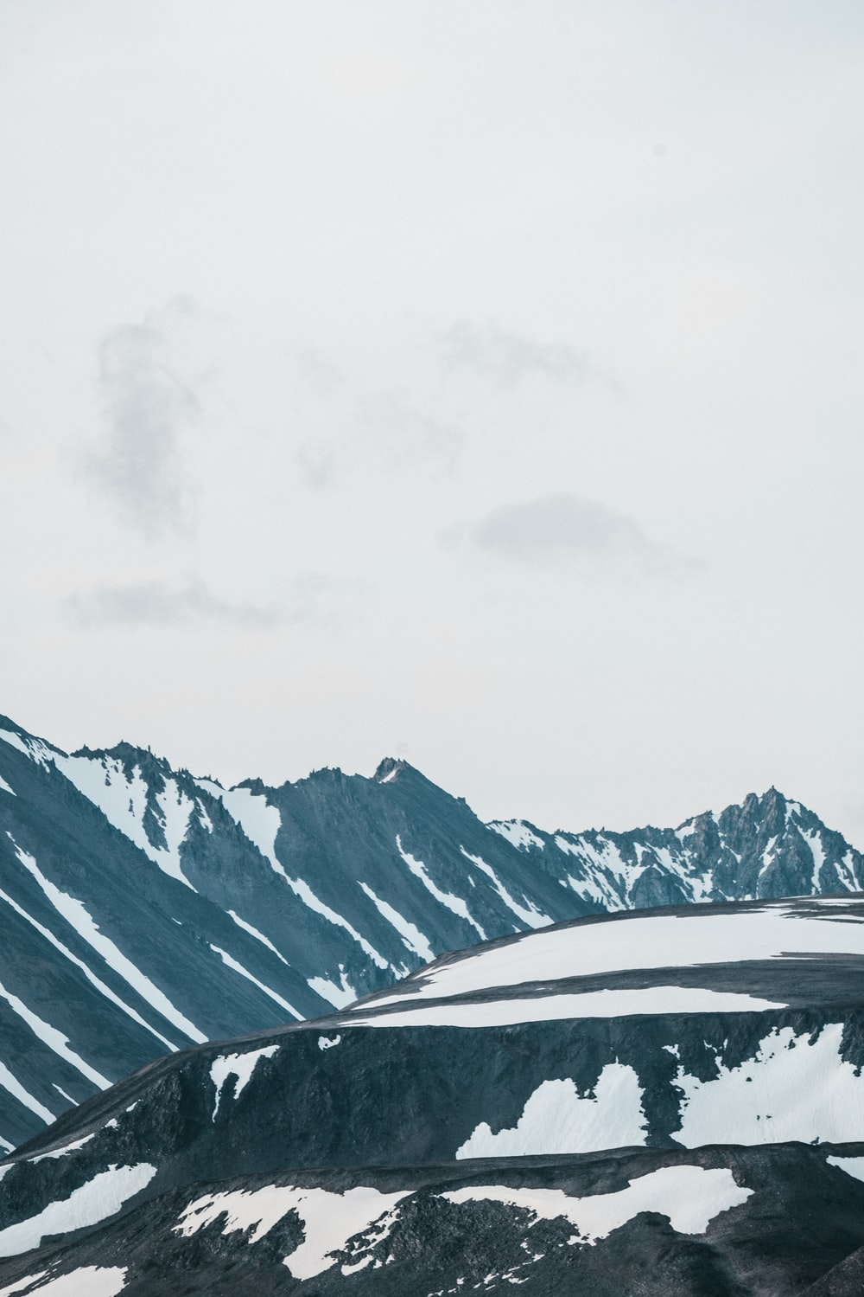
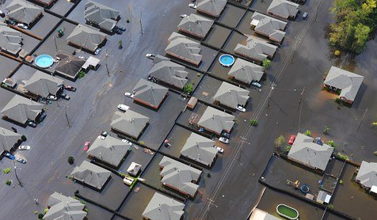
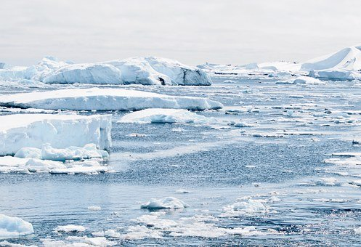
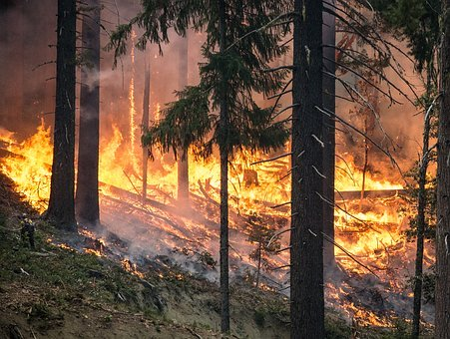
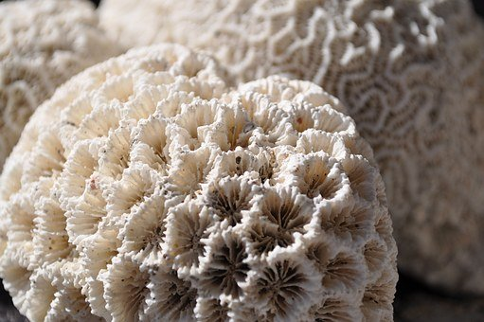
A closer look at the evidence

Slide 5
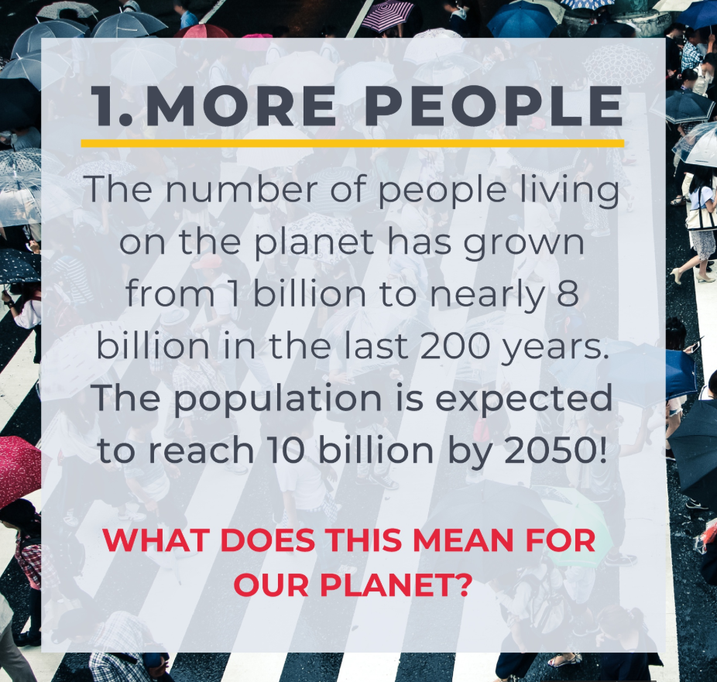
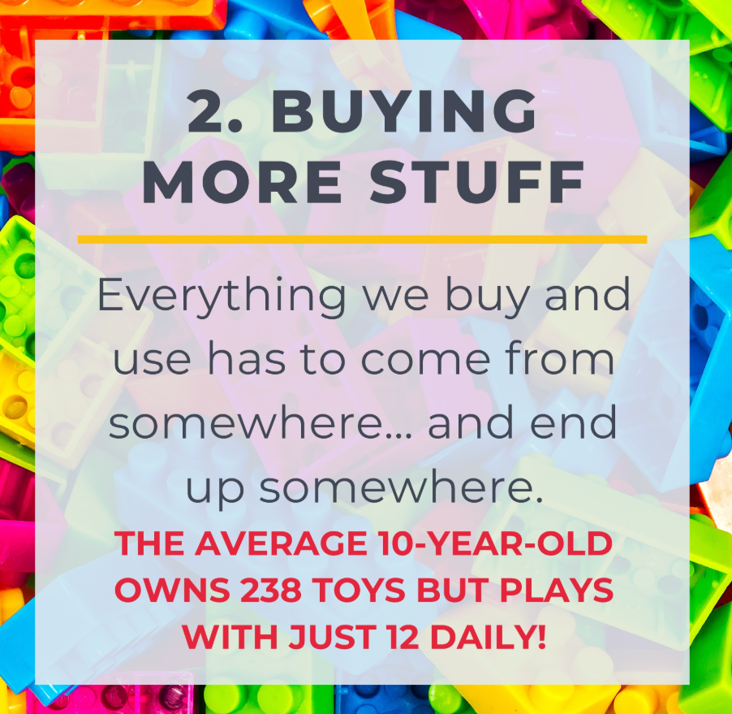
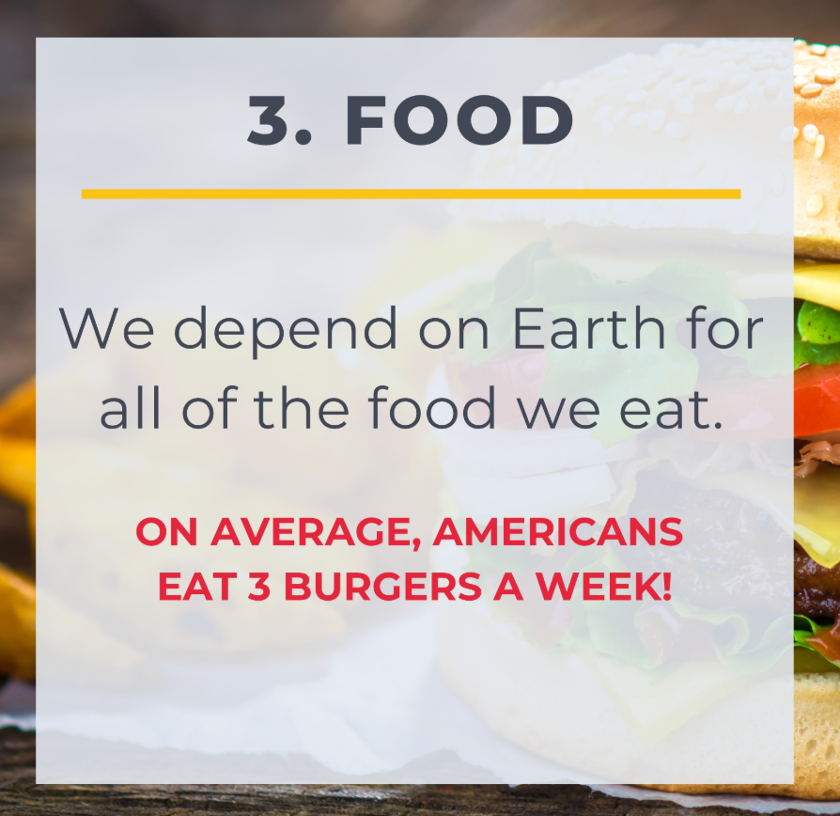
What’s leading to this?
This leads to an increase in harmful gases into our atmosphere… these are called Greenhouse Gases!

Slide 6
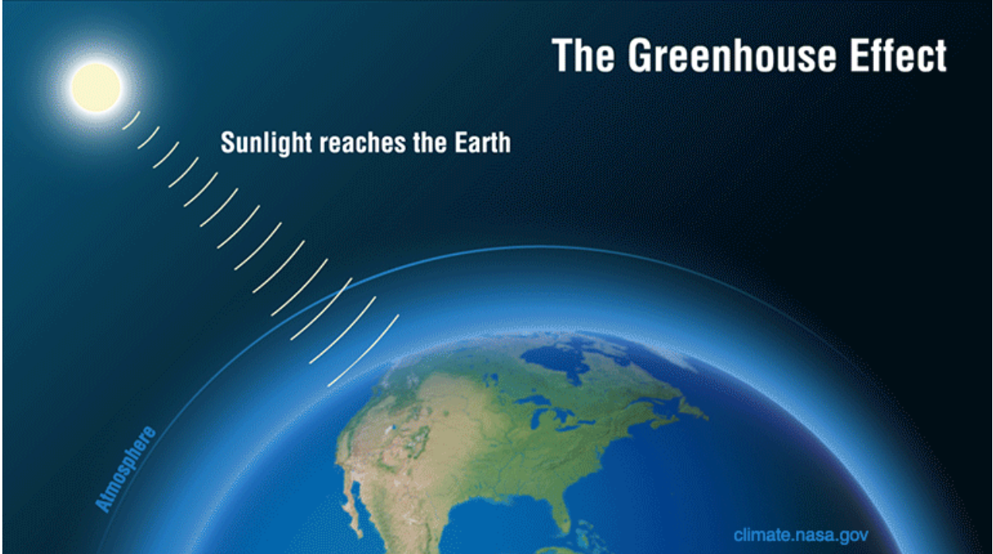
What has caused this?
Greenhouse gases

Slide 7







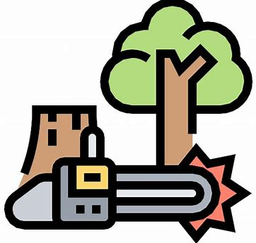
Where do greenhouse gases come from?
Carbon Dioxide
Methane
Nitrous Oxide

Slide 8
WHAT WILL THE WORLD LOOK LIKE IF CLIMATE CHANGE CONTINUES?

Slide 9
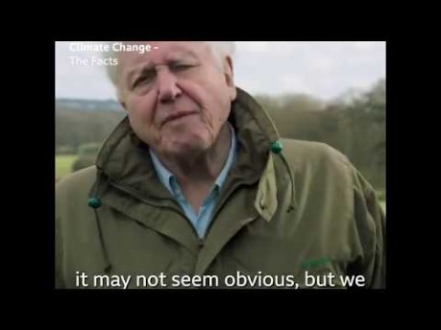

Slide 10

What is a carbon footprint?
Your carbon footprint!
We may not realise it, but we ALL emit carbon dioxide through our day-to-day activities.
Your carbon footprint measures your individual impact on the planet based on the amount of carbon dioxide you emit.
By making different decisions, we can increase or decrease our carbon footprint.
The most common emitters than we can help to reduce are:

Slide 11
ACTIVITY: THINKING ABOUT YOUR FOOTPRINT!

Slide 12






Solving the problem
The role of renewable energy
Non-renewable energy comes from resources that are not replaced, or are replaced only very slowly by natural processes.
Renewable energy is energy from sources that are naturally replenishing.

Slide 13
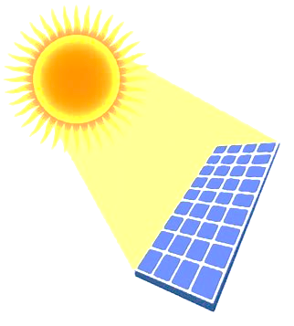
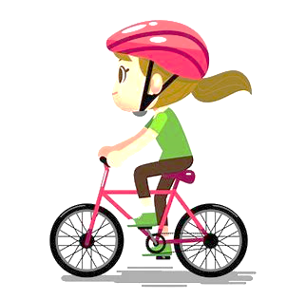

What can you do?
Protect the planet
1
2
3
.
.
.
Use less electricity or a different type!
Use the car less!
Eat less meat!

Slide 14
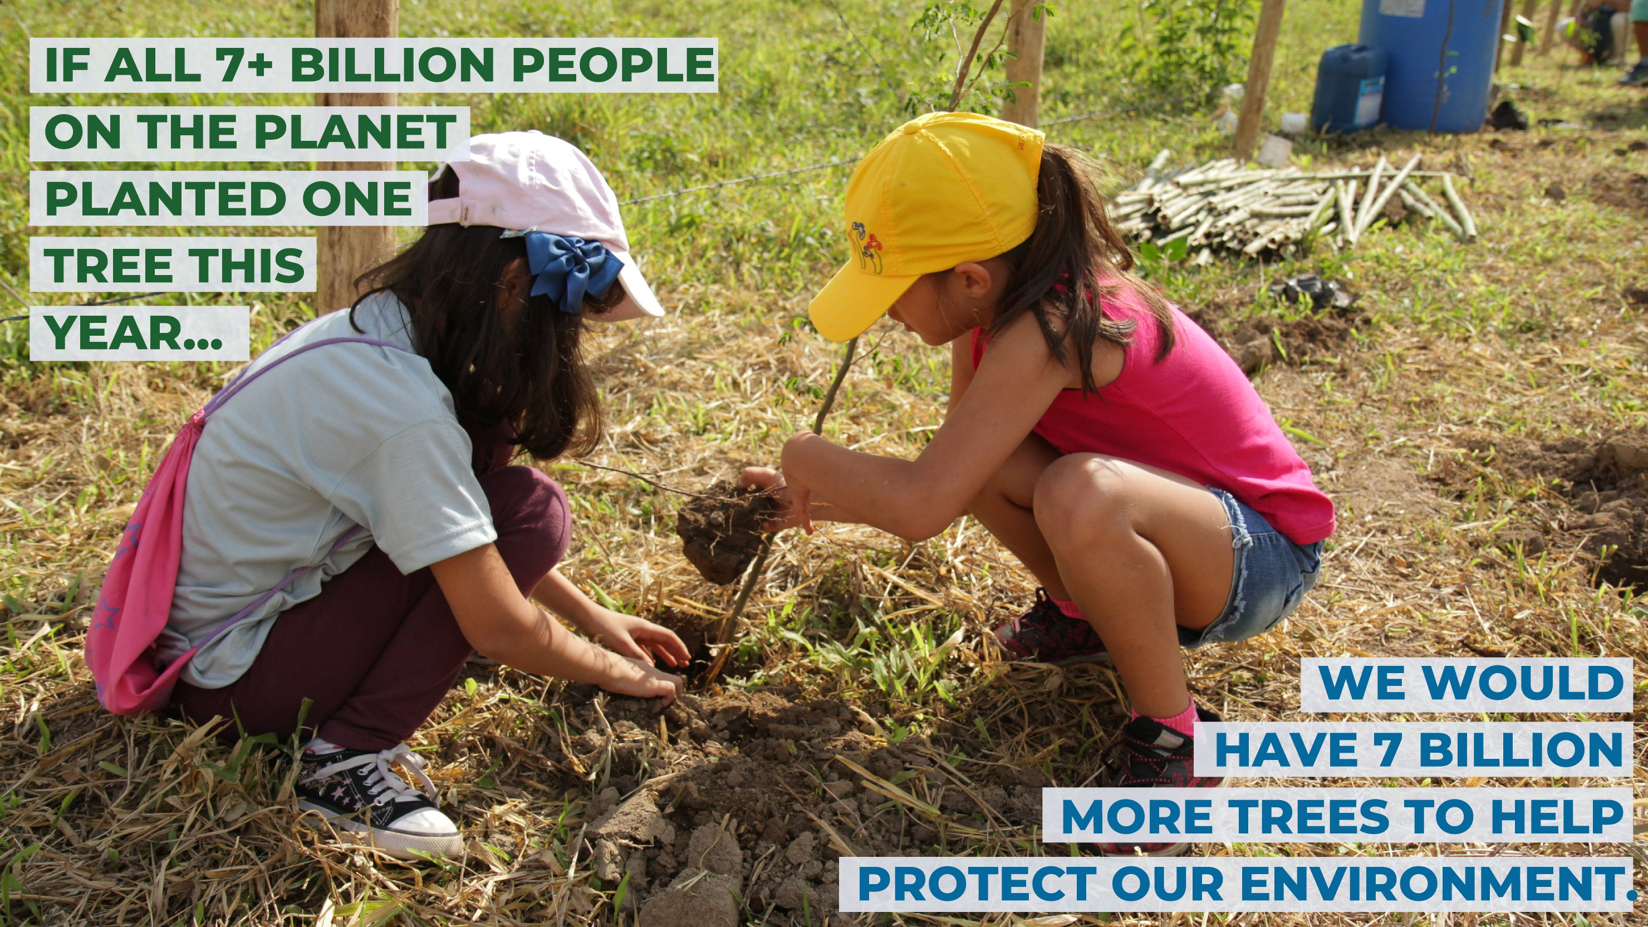
We can plant trees

Slide 15
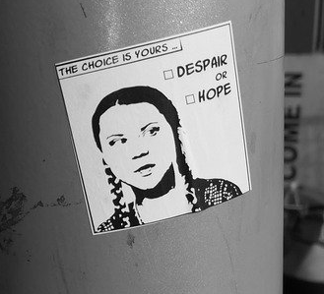
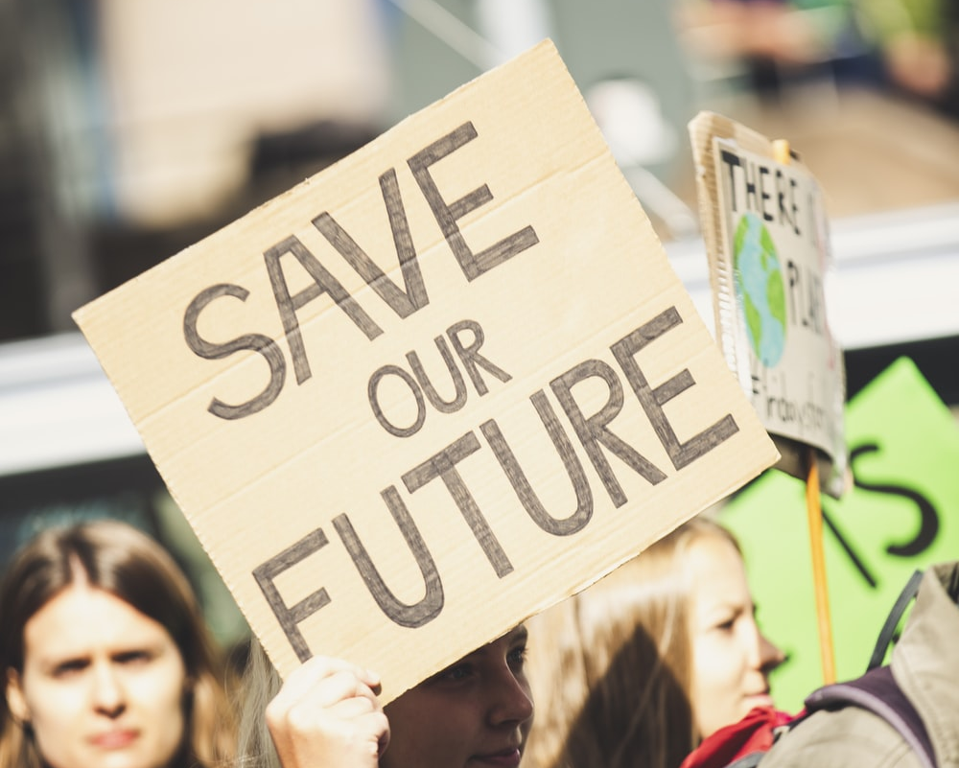
TALK ABOUT CLIMATE CHANGE
Speak up and inspire others to make a change

Slide 16
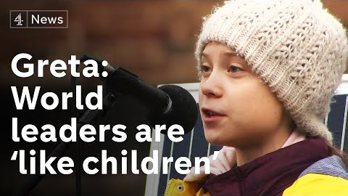

Slide 17
Thank you!
And now, to do some research…

