Slide 1
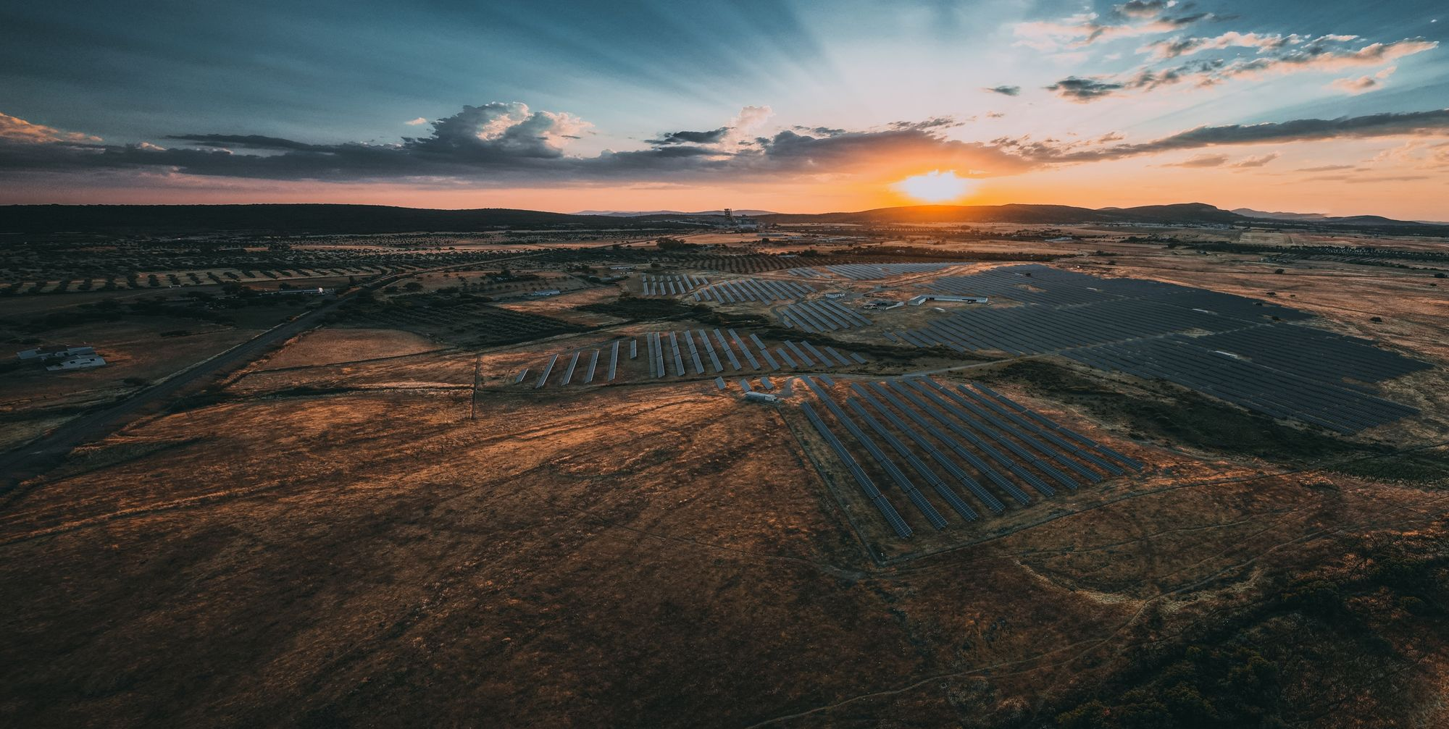
Sonnedix
sustainability
academy
Powering a Bright Future:
An intro to solar energy (primary)

Slide 2



Imagining a world without electricity

Slide 3
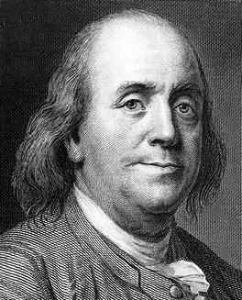
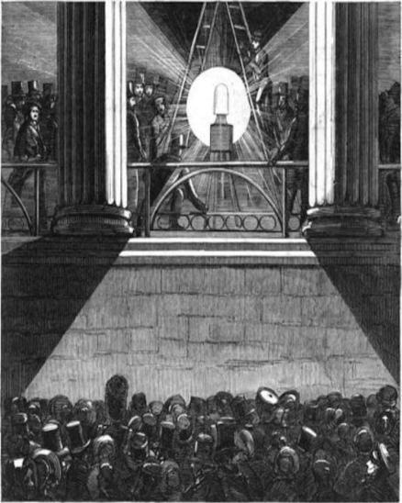
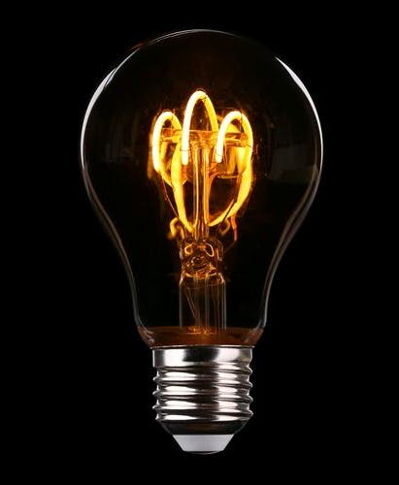
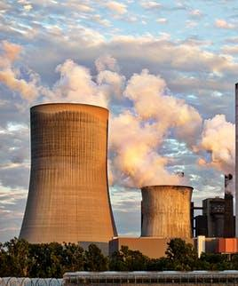
What is electricity?
Electricity is a big part of our lives, and sometimes we don’t even realize it.
First, let’s take a look at what electricity is.

Slide 4


Where does electricity come from?

Slide 5

What is climate change?

Slide 6
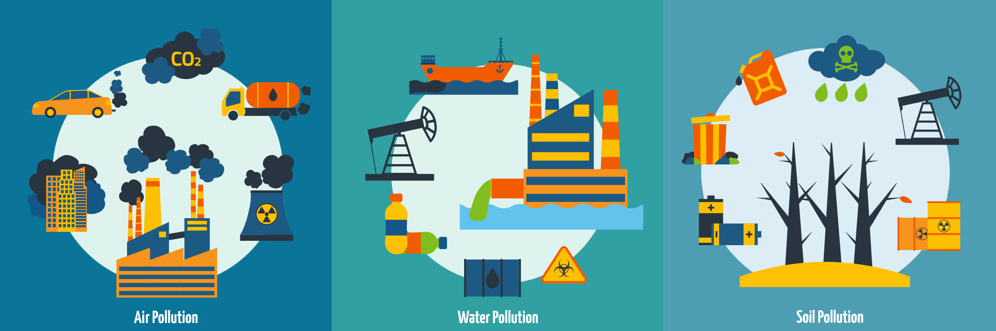
What is causing it?

Slide 7
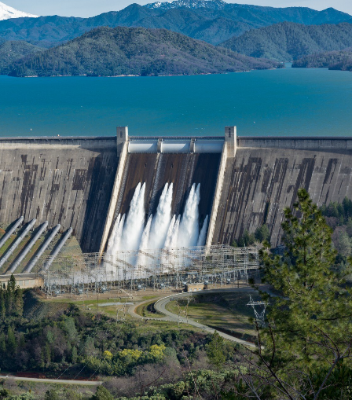
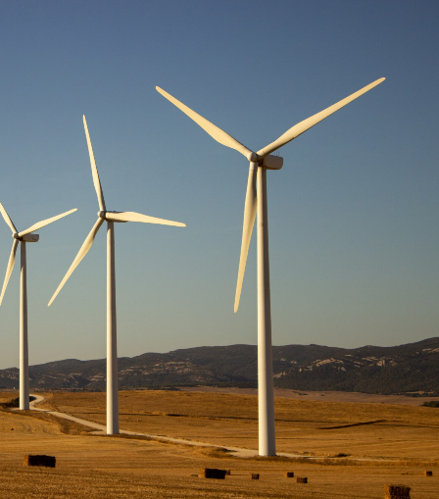
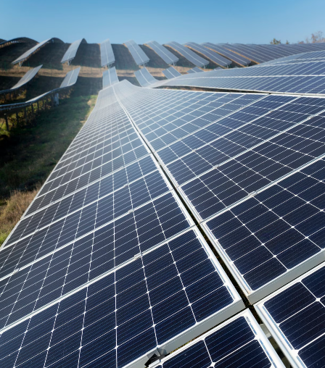
What can we do about it?
We need electricity, but producing it can be harmful to the planet.
How else can we produce electricity?
WATER
WIND
SOLAR

Slide 8




What is solar energy?
We need electricity, but producing it can be harmful to the planet.
How else can we produce electricity?
01
02
03
The sunglight shines onto the solar panels
The solar panel, containing solar cells, converts the suns energy into electricity
The solar power can then be used to produce electricity to power everything!
DID YOU
KNOW?
It takes sunlight an average of 8 minutes and 20 seconds to travel from the sun to the Earth’s surface!

Slide 9
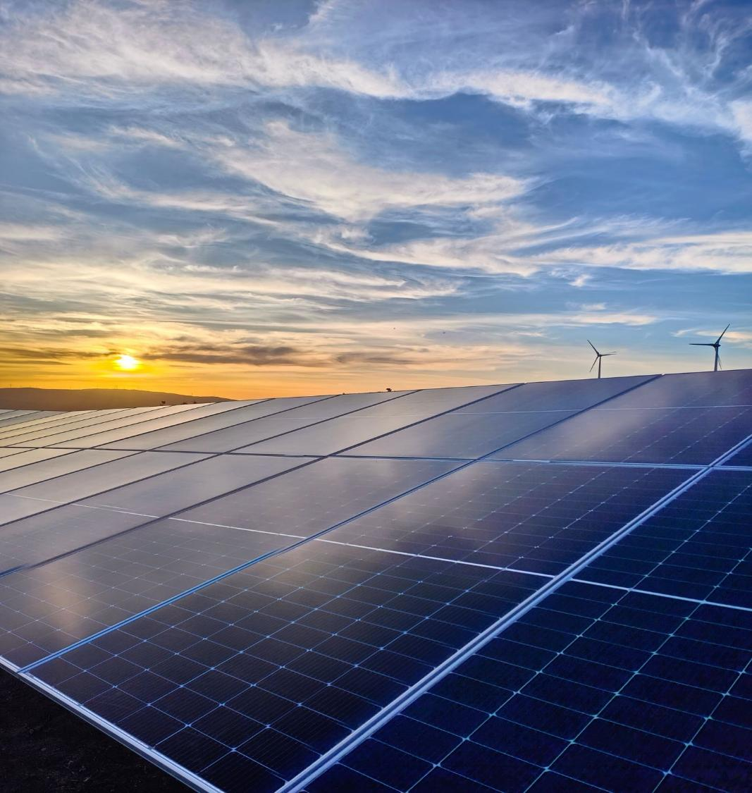




Why do we need renewable energy?
For climate change!
Less impact
on animals!
Less
pollution!
The sun won’t run out!

Slide 10
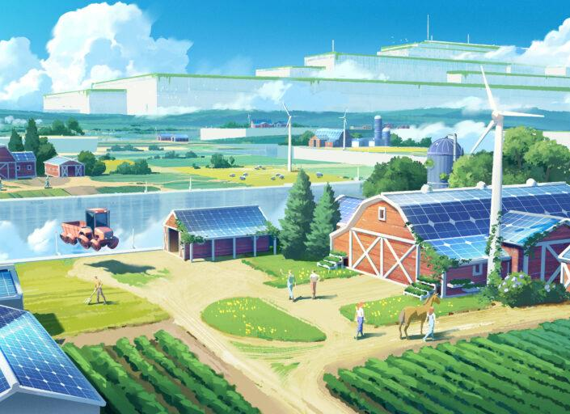
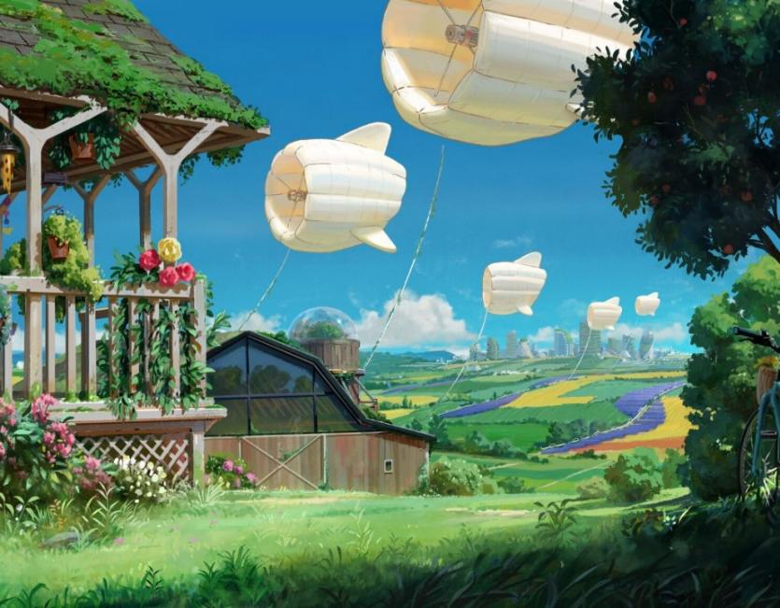
The future?

Slide 11

Our vision is to
Power a Bright Future!
What´s yours?
We urge everyone to become leaders in climate change, to spread the word, and to be a part of the climate solution.

Slide 12

ACTIVITY: Make a pledge!
Email your pledge at esg@sonnedix.com

Slide 13

Thank you for playing your part to fight climate change!
Do you want to know more? If so, find more resources about climate change, solar and other topics related to sustainable development at Sonnedix Sustainability Academy:
www.sonnedix.com/sustainability-academy

