Slide 1
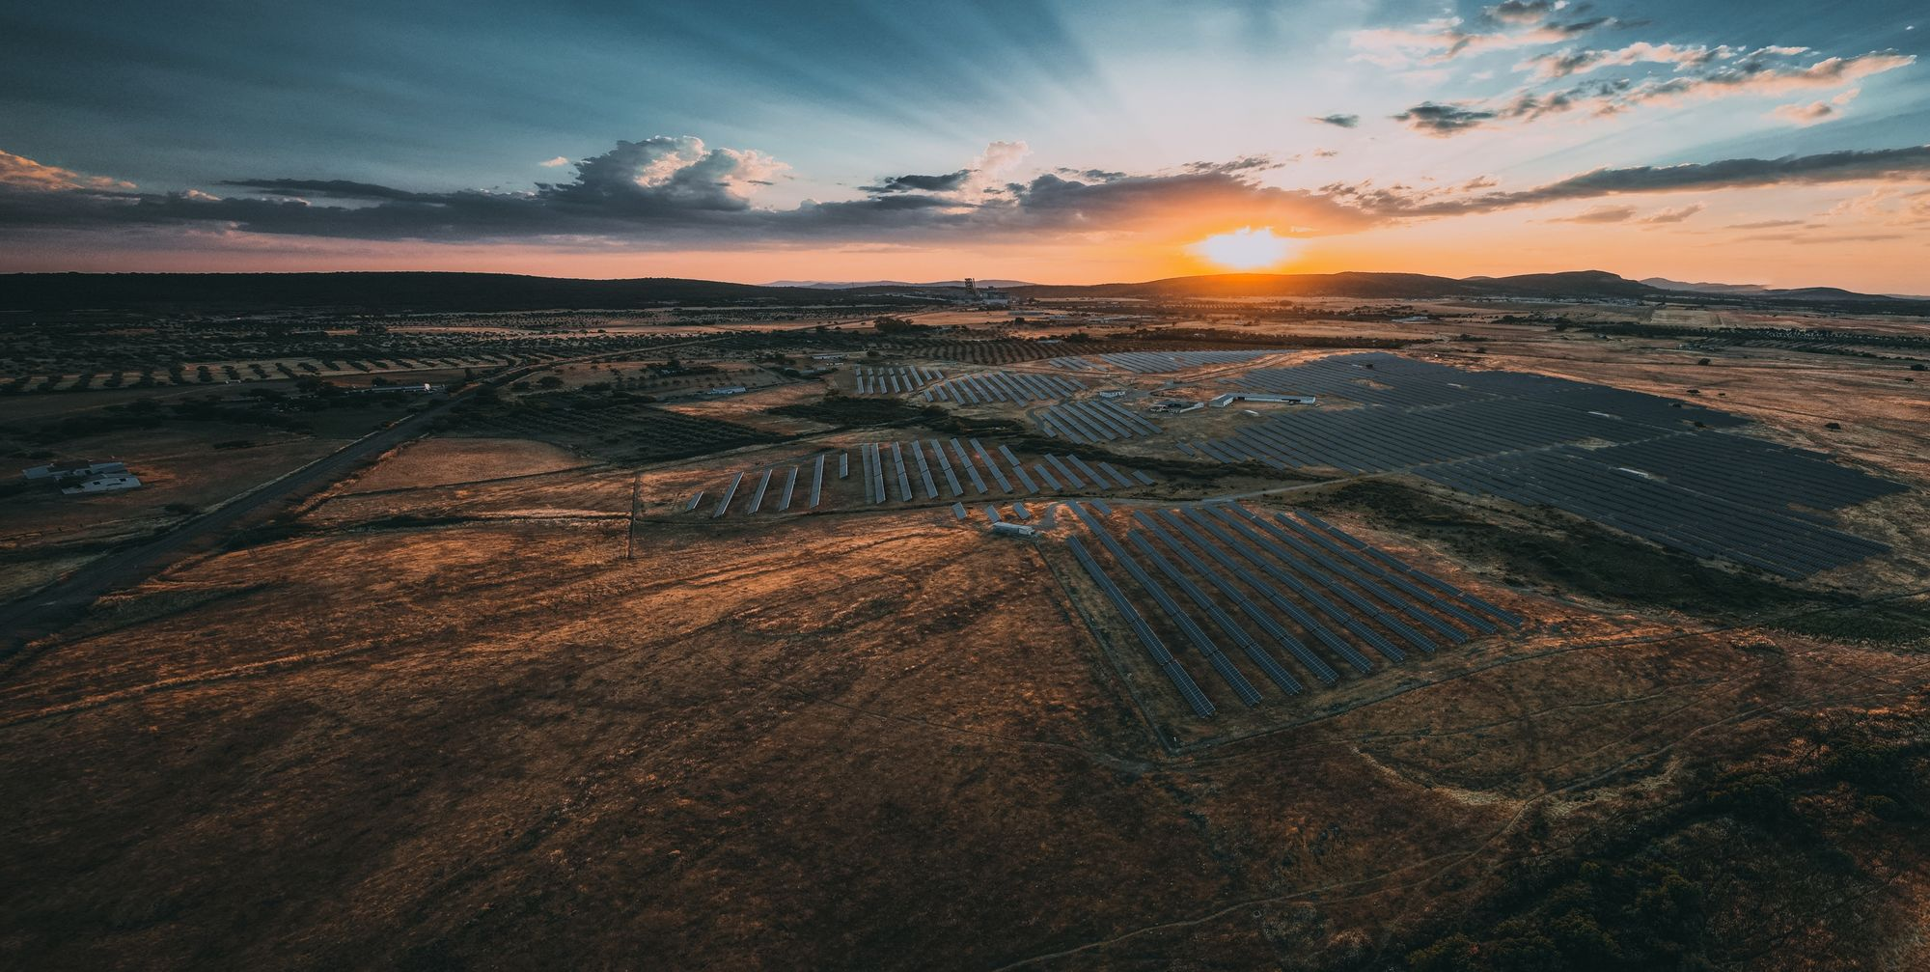
Sonnedix sustainability academy
Climate Change (Age 5-8)

Slide 2
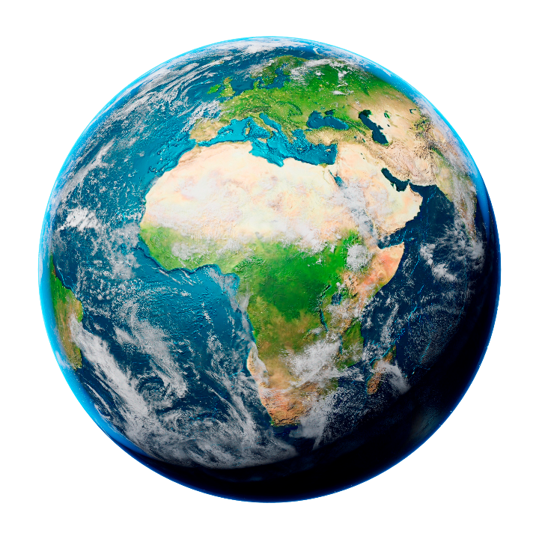
But our earth is changing

Slide 3

But our earth is changing

Slide 4
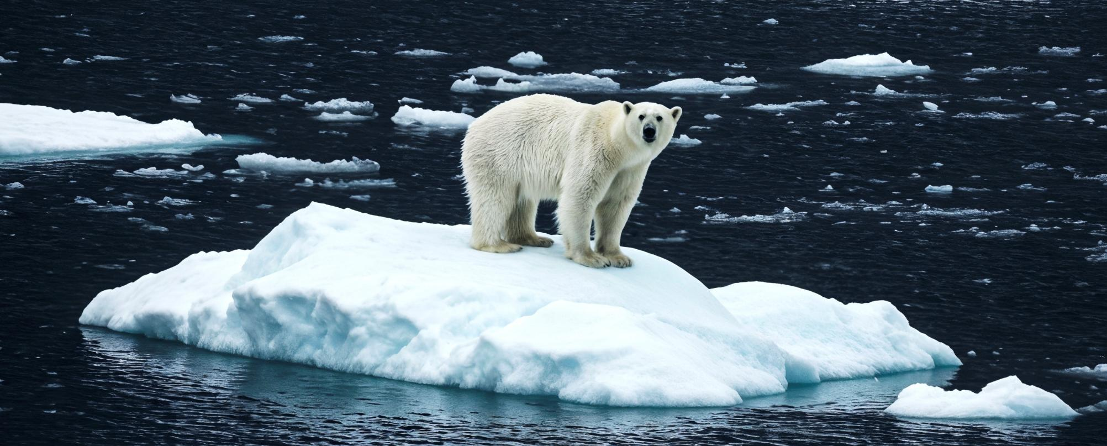
What does climate change look like? – The Artic

Slide 5
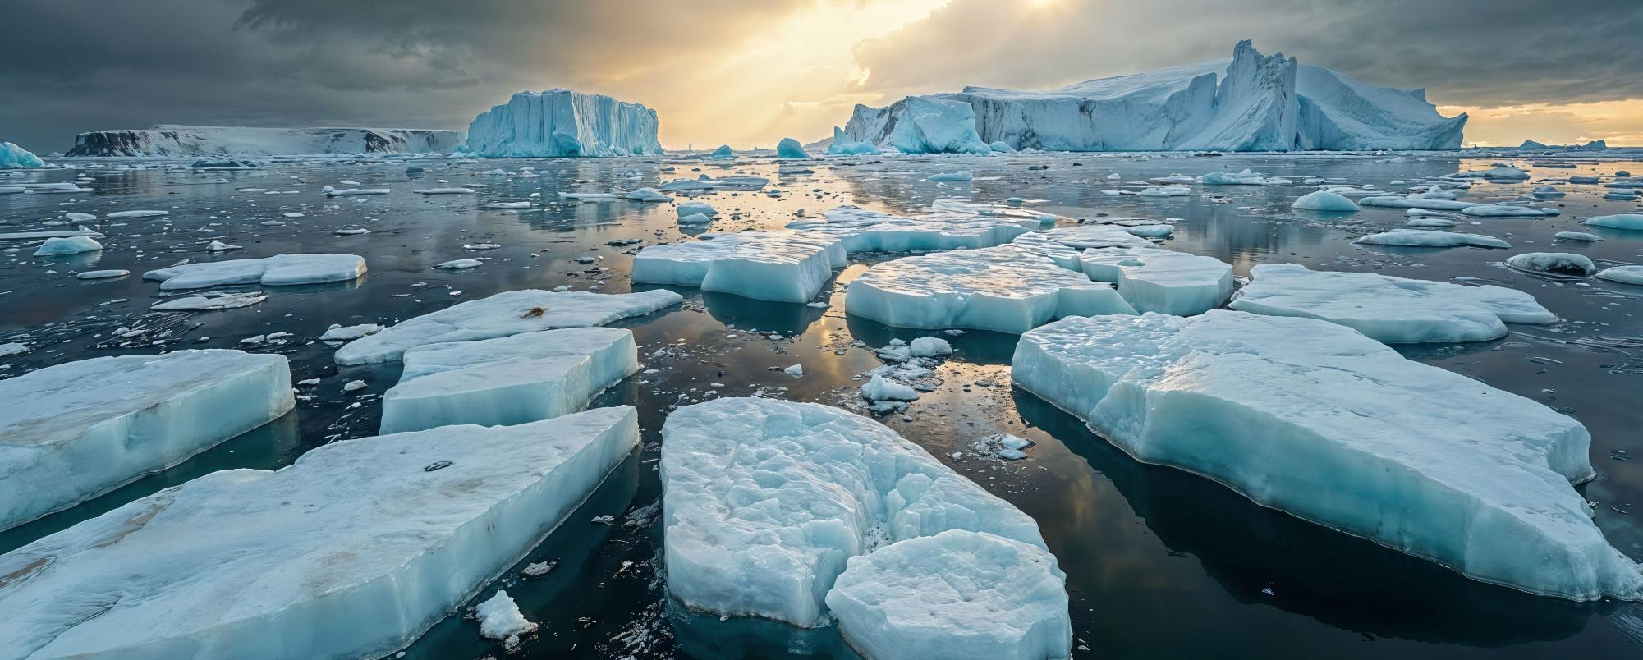
What does climate change look like? – The Artic

Slide 6
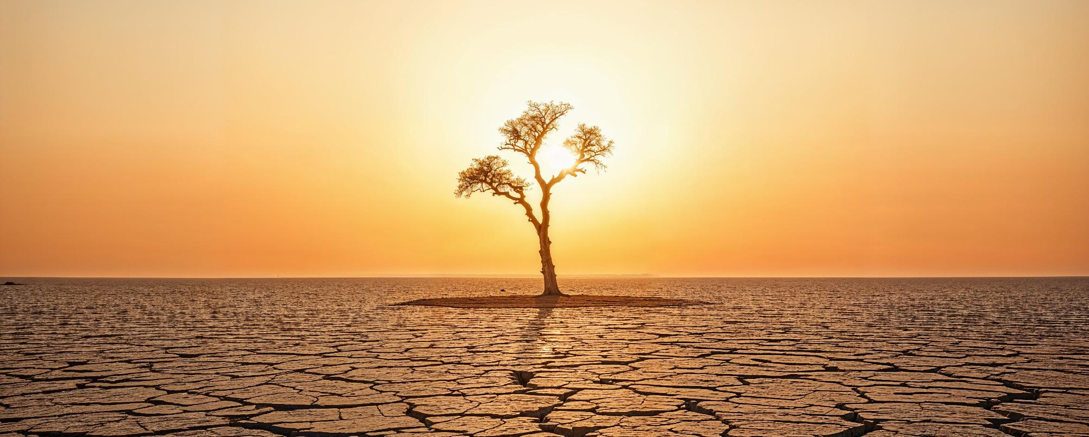
What is climate change?

Slide 7
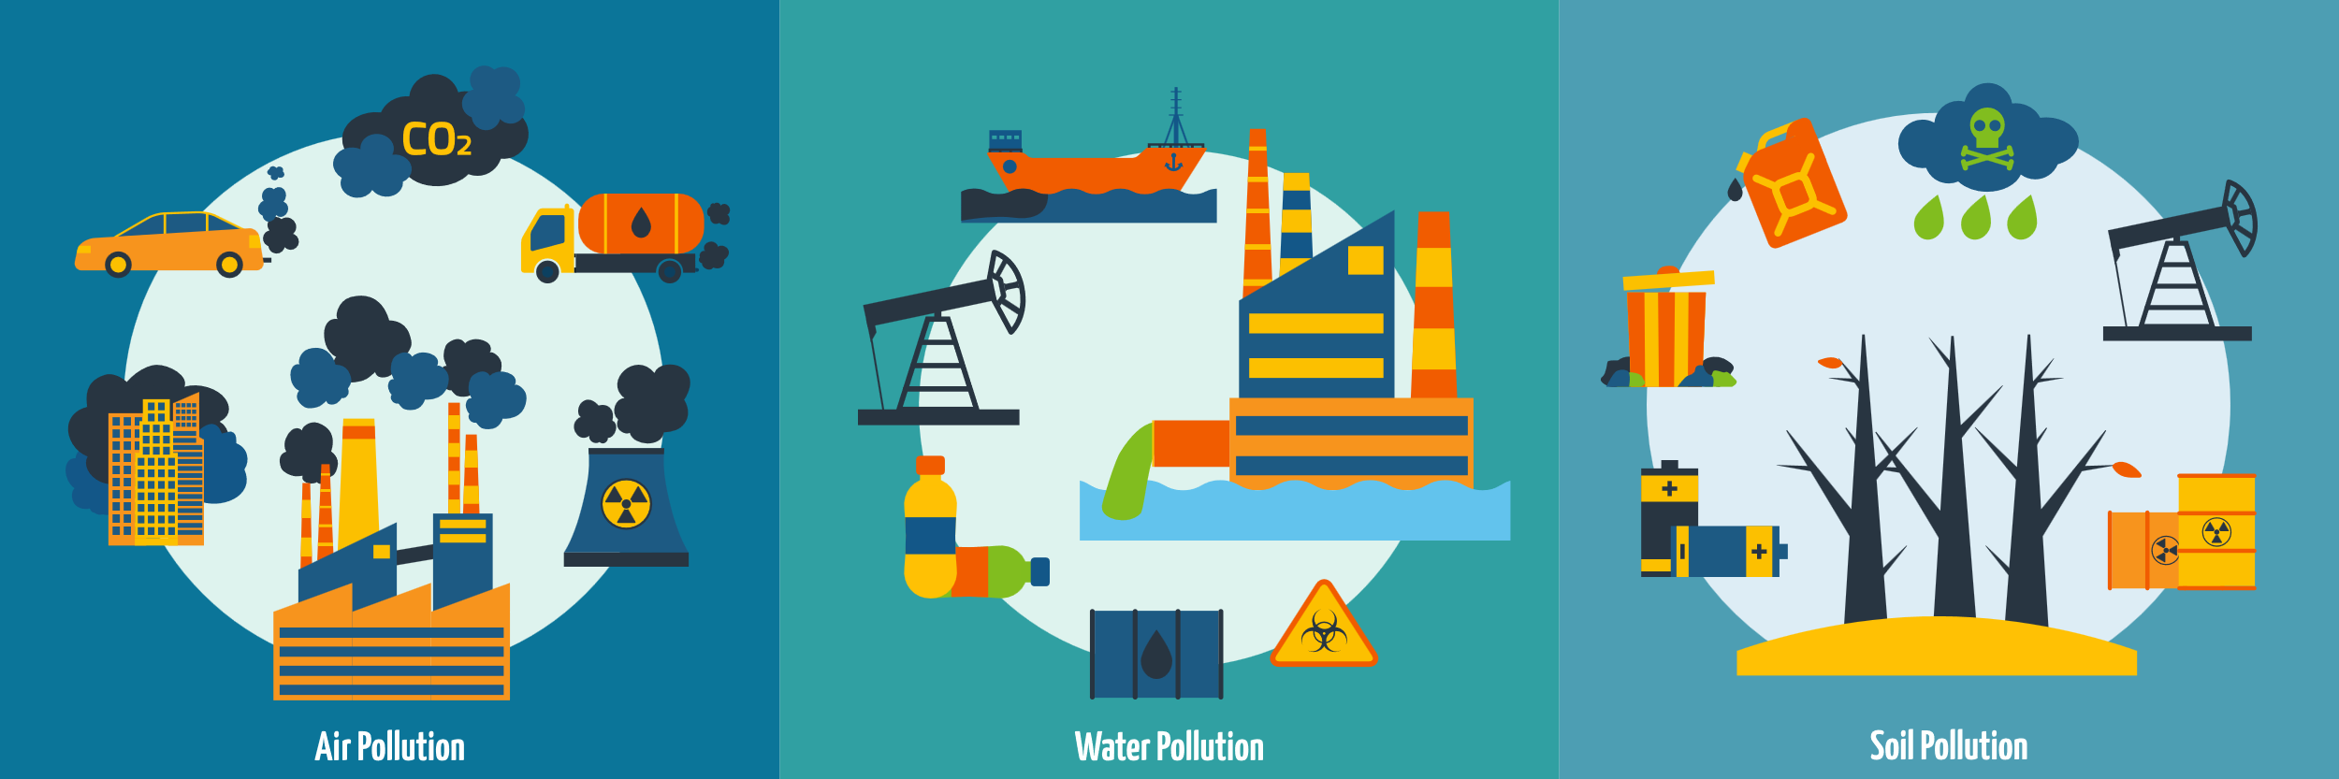
What is causing it?

Slide 8

ACTIVITY: What can we do?

Slide 9
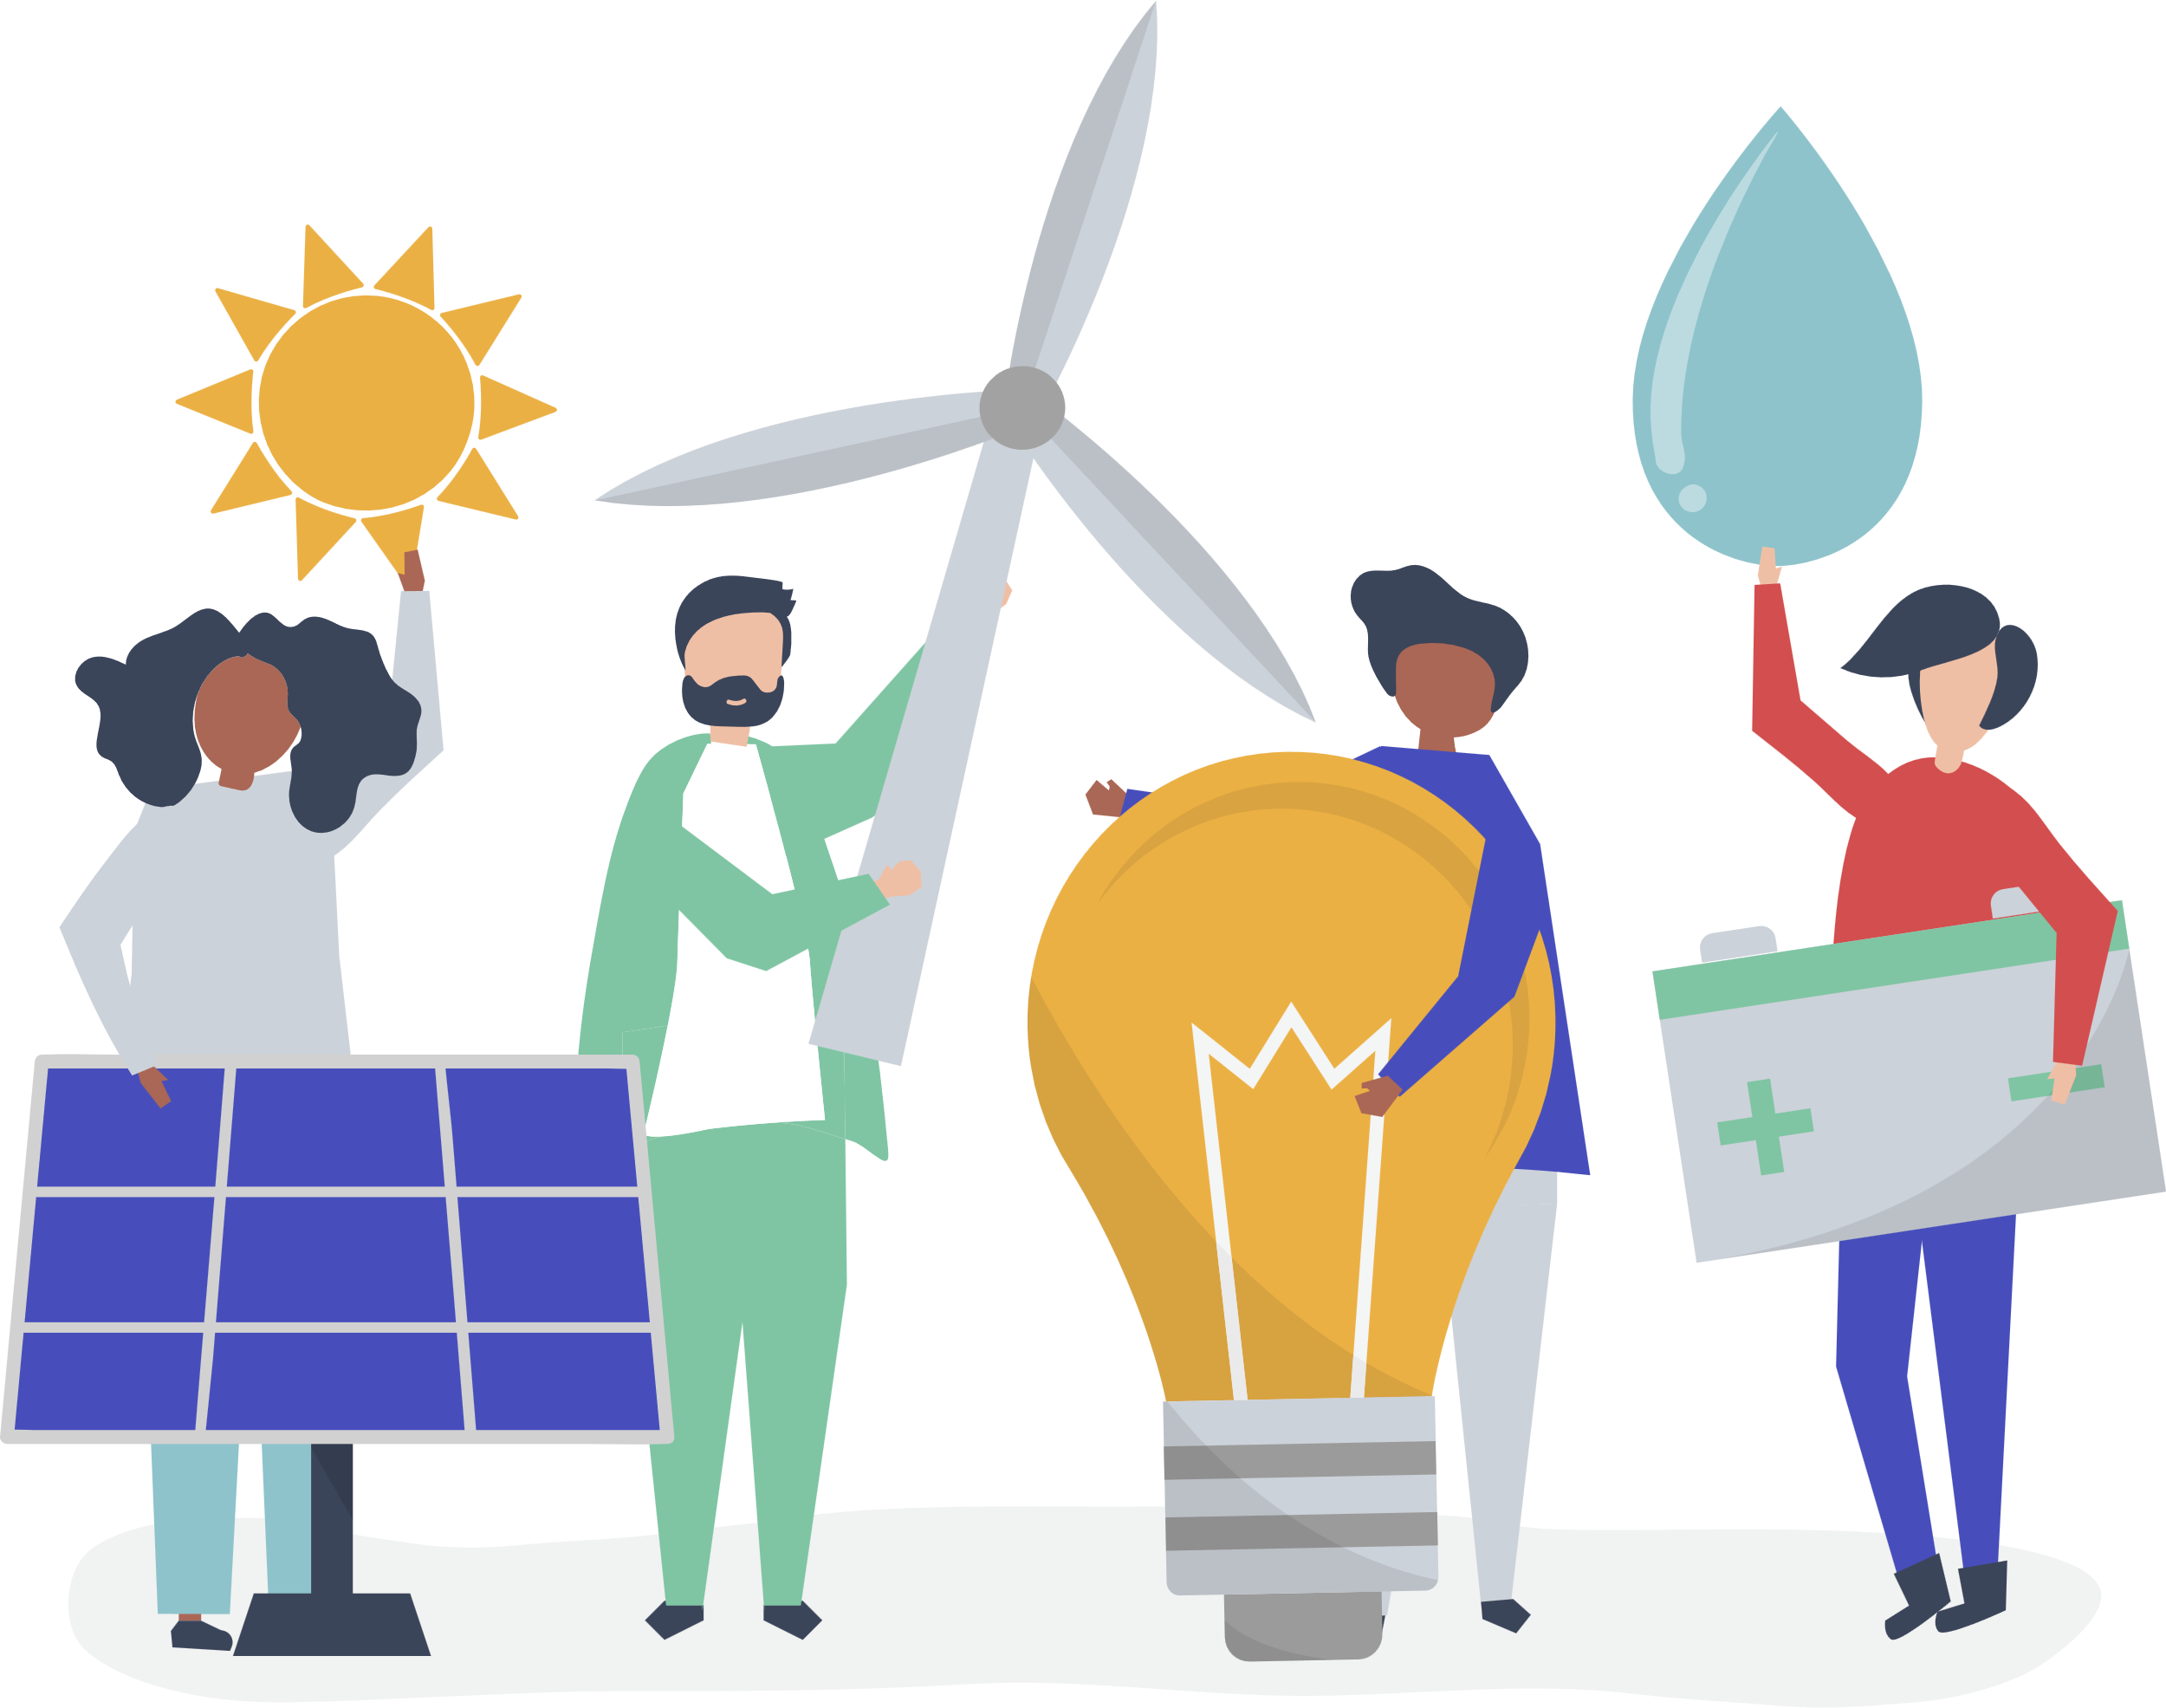
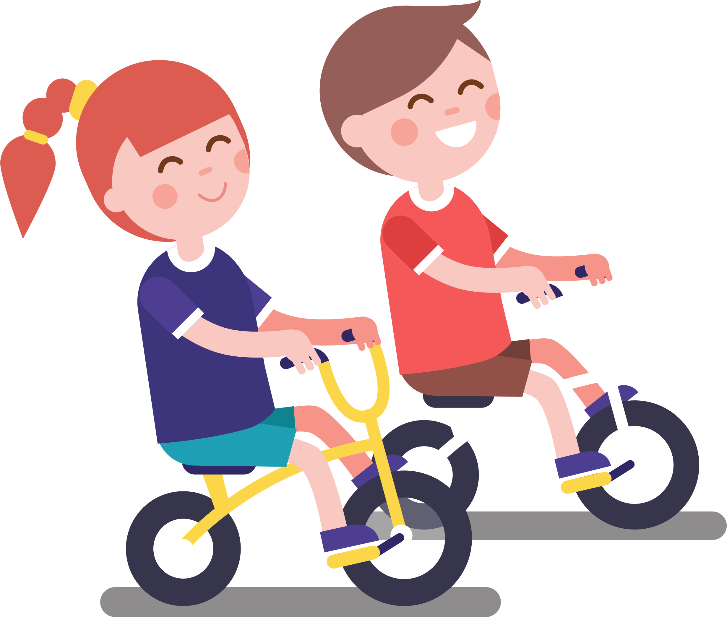

What can you do?
Protect the planet
1
2
3
Use less electricity or a different type!
Use the car less!
Eat less meat!

Slide 10
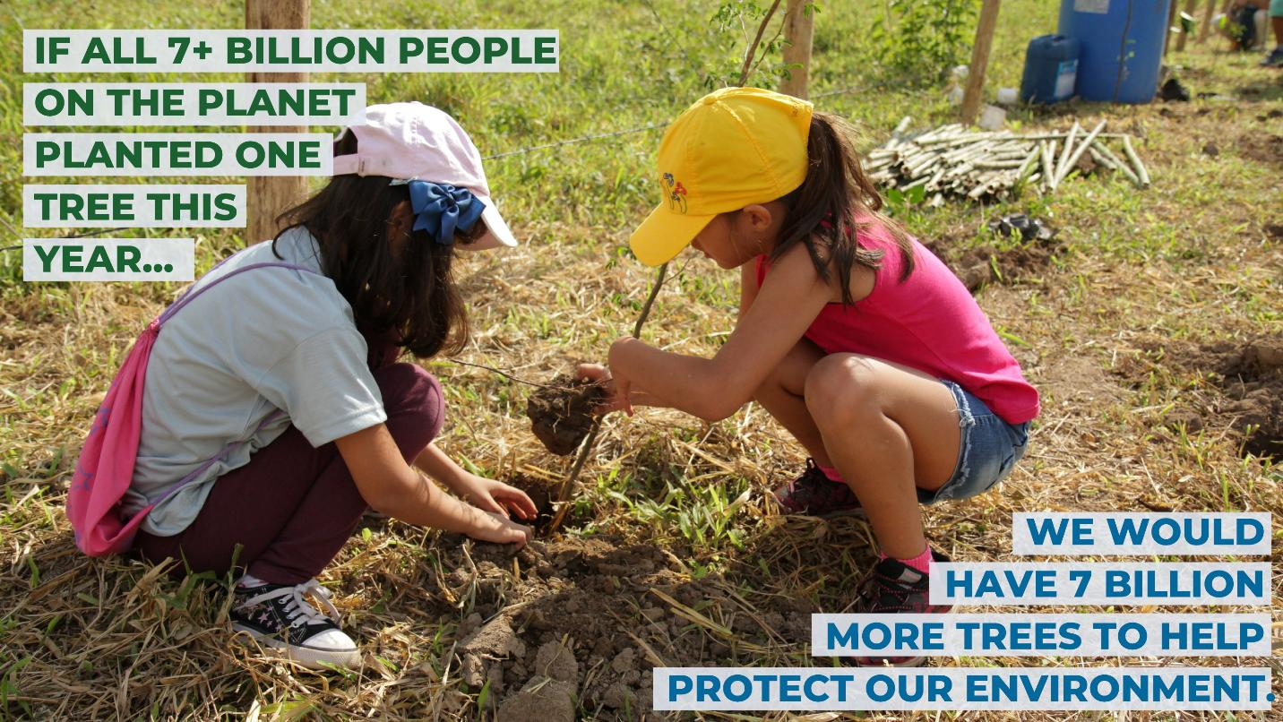
We can plant trees

Slide 11
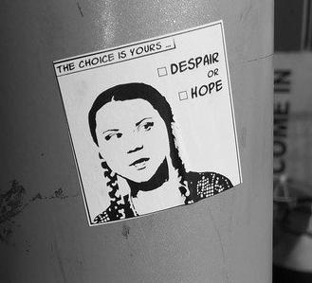
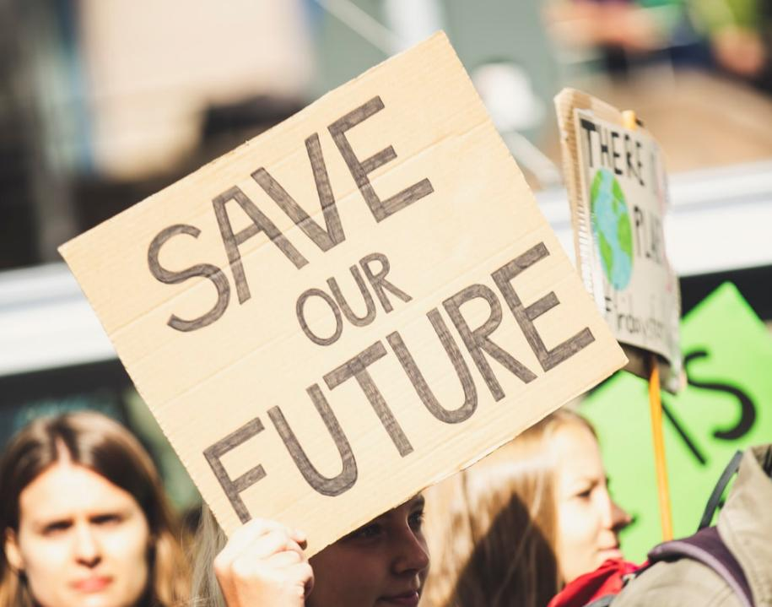
Talk about climate change
Speak up and inspire others to make a change

Slide 12

ACTIVITY: Make a pledge!

