Slide 1
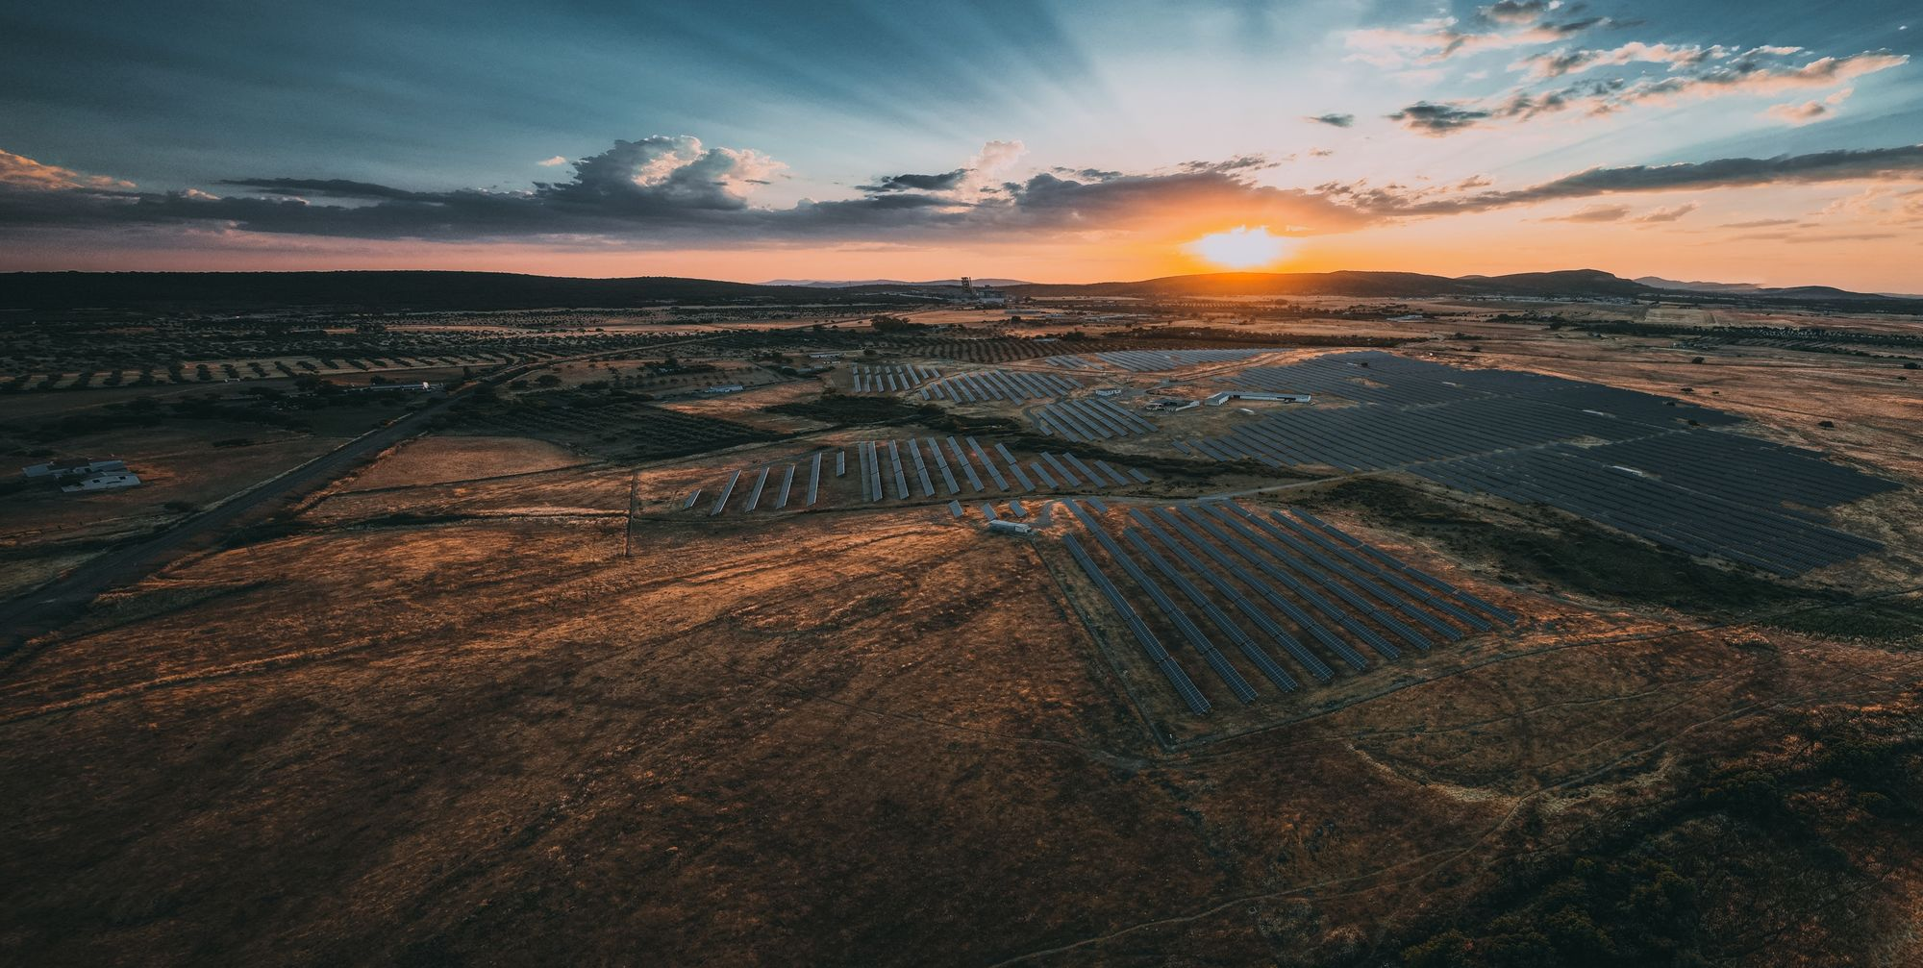
Sonnedix sustainability academy
Climate Change (Age 14-16)

Slide 2
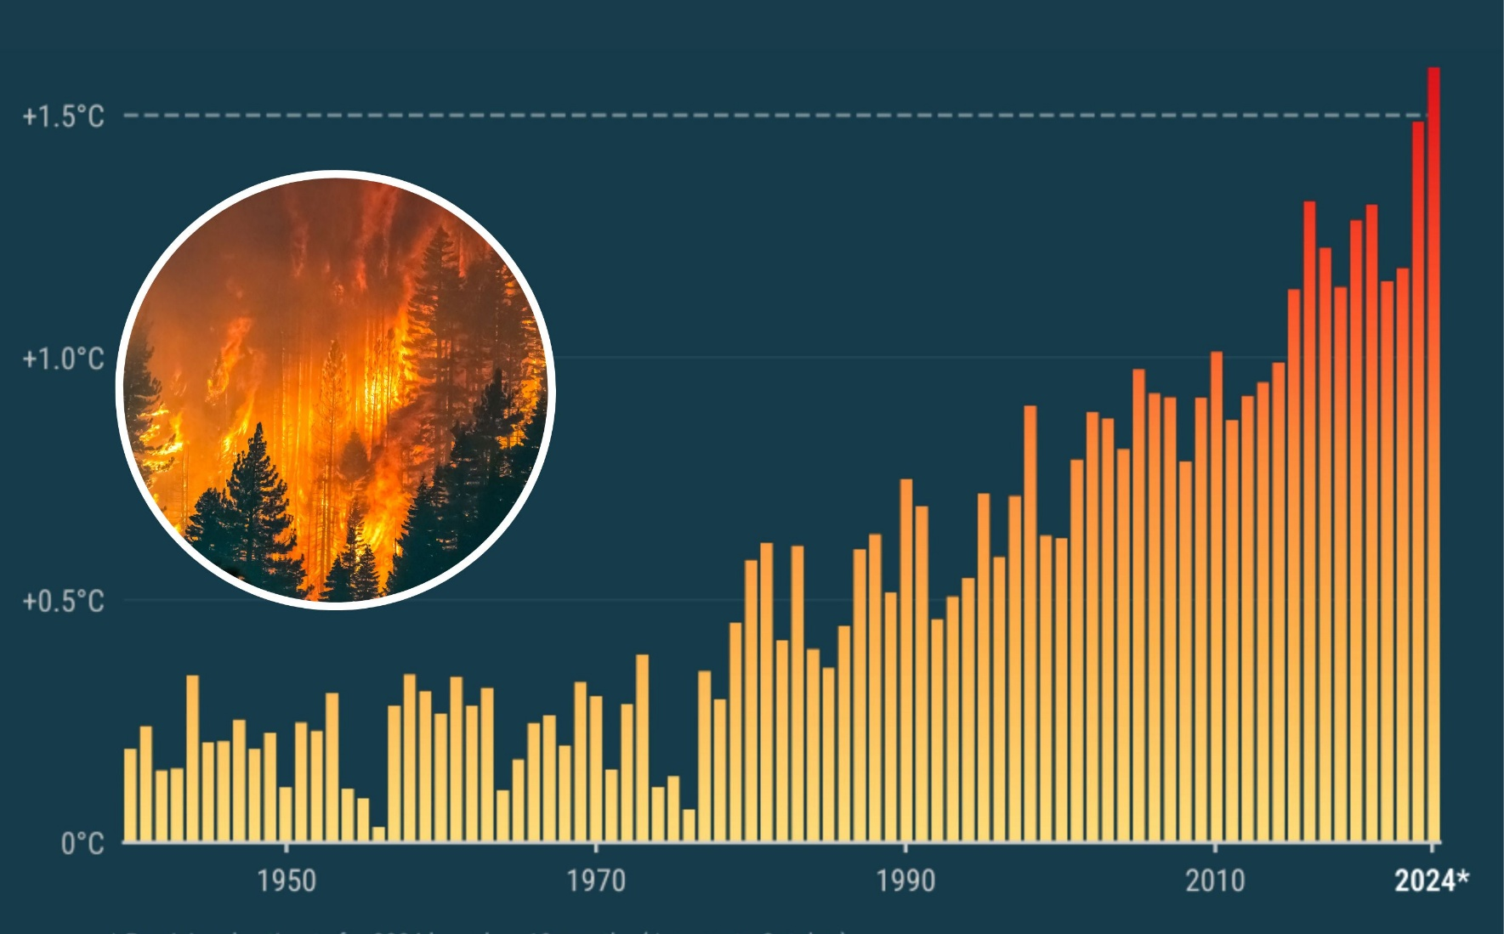
What is climate change?
The Earth’s climate has changed throughout history.
Within the Earth’s history, there have been numerous examples of a changing climate.
The beginning of the modern climate era began 11,700 years ago with the end of the last ice age.
So why is current climate change an issue?
The current climate change is of particular significance because it is extremely likely to be the result of human activity and is occurring at a much faster rate.

Slide 3
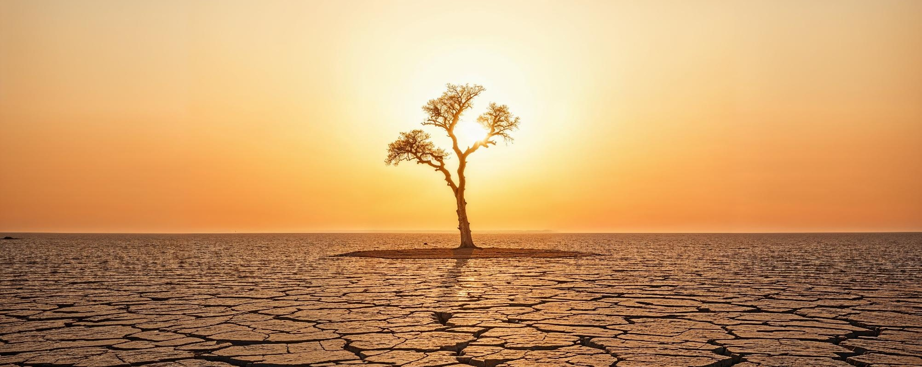
A closer look at the evidence

Slide 4
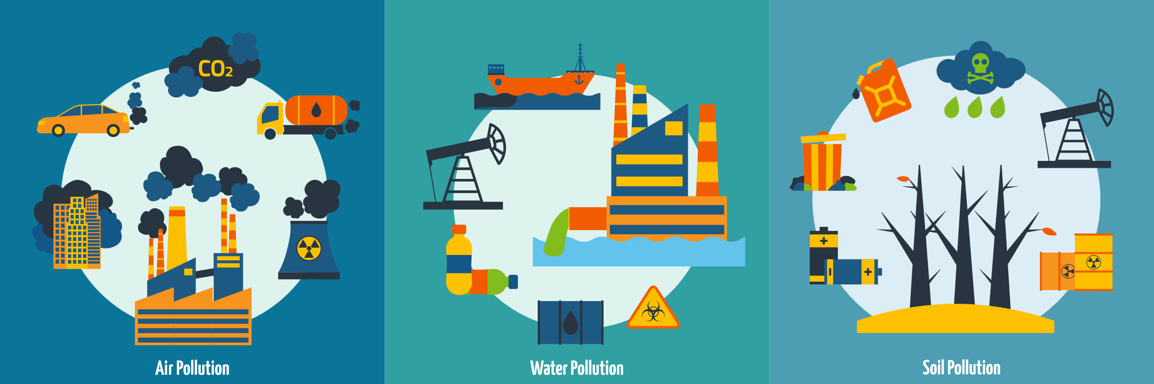
What is causing it?

Slide 5

What is causing it?
Greenhouse gases

Slide 6
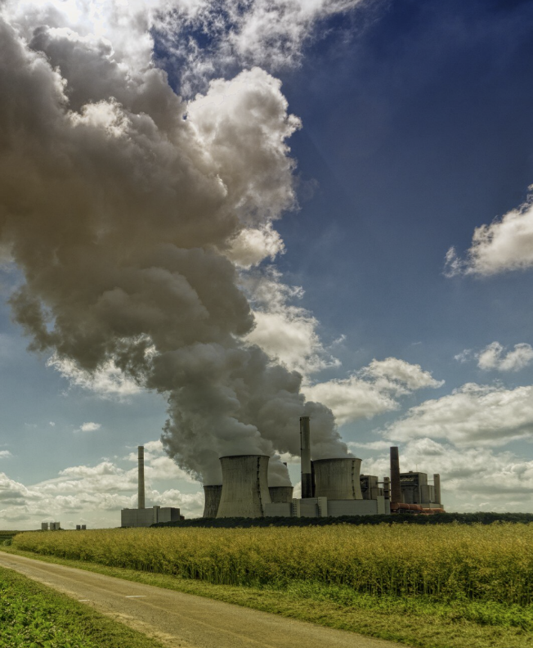
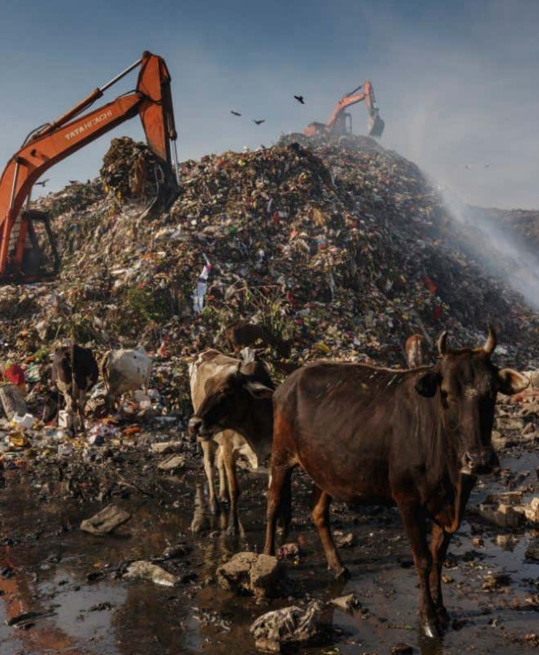
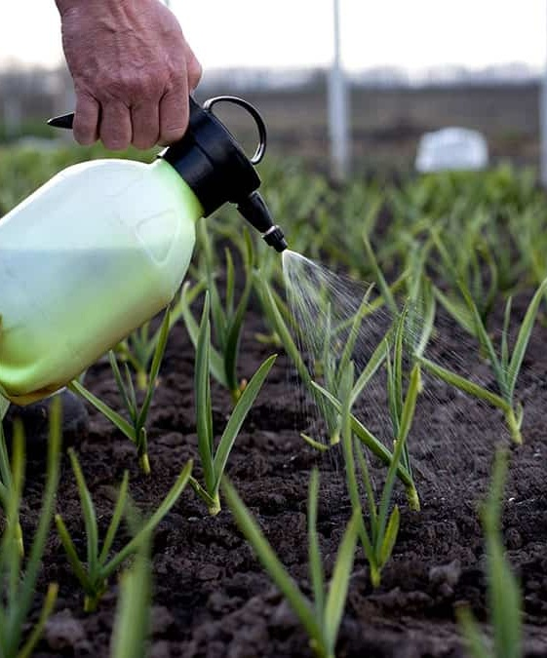
Where do greenhouse gases come from?
Carbon Dioxide
Methane
Nitrous Oxide

Slide 7
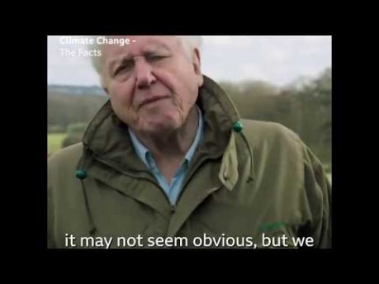
What will the world look like if climate change continues?

Slide 8

What is a carbon footprint?
We may not realise it, but we ALL emit carbon dioxide through our day-to-day activities.
Your carbon footprint measures your individual impact on the planet based on the amount of carbon dioxide you emit.
By making different decisions, we can increase or decrease our carbon footprint.
The most common emitters than we can help to reduce are:

Slide 9

ACTIVITY: Thinking about your footprint!

Slide 10






Solving the problem
The role of renewable energy
We can produce electricity through two main sources: Renewable and non-renewable sources!
Non-renewable energy comes from resources that are not replaced, or are replaced only very slowly by natural processes.
Renewable energy is energy from sources that are naturally replenishing.

Slide 11
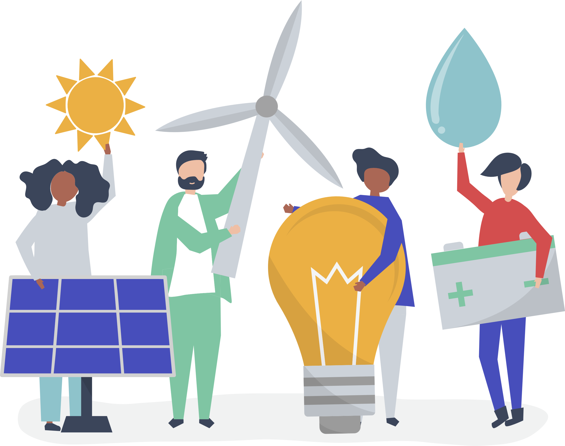


What can you do?
Protect the planet
1
2
3
Use less electricity or a different type!
Use the car less!
Eat less meat!

Slide 12
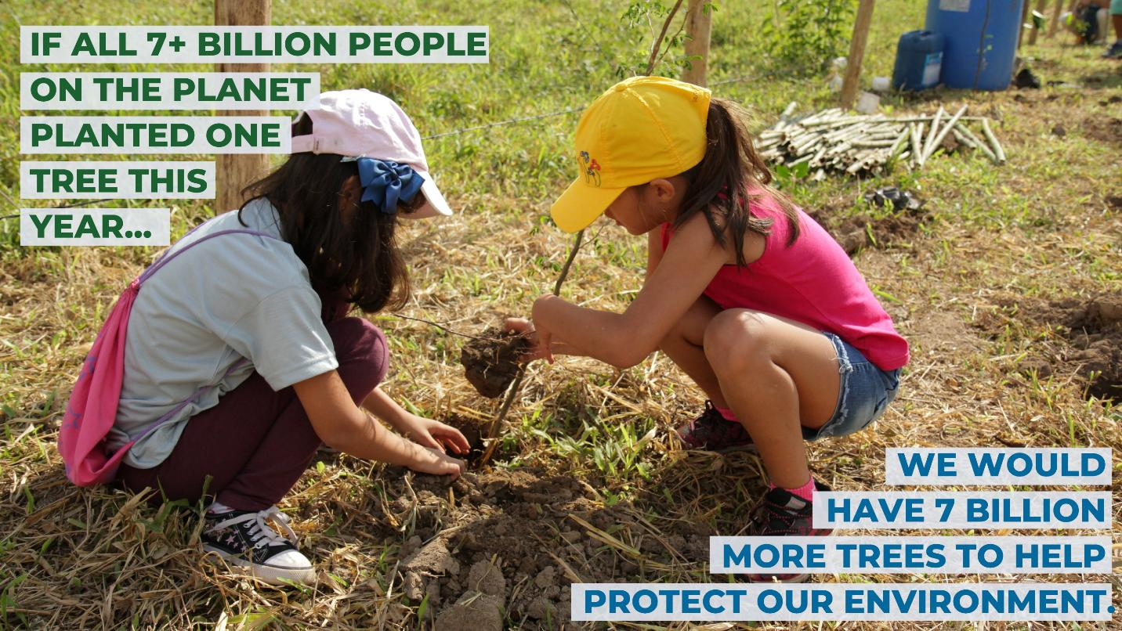
We can plant trees

Slide 13
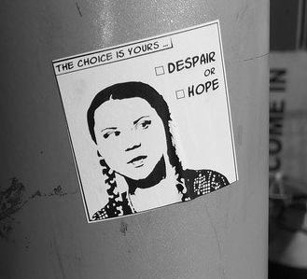
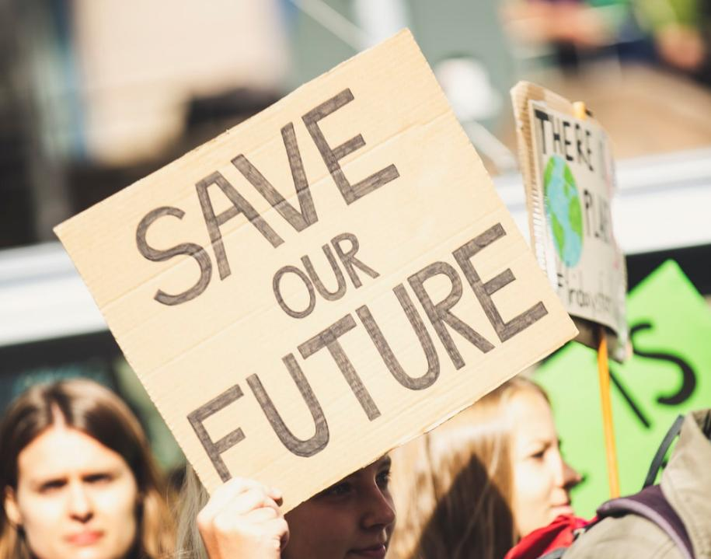
Talk about climate change
Speak up and inspire others to make a change

Slide 14
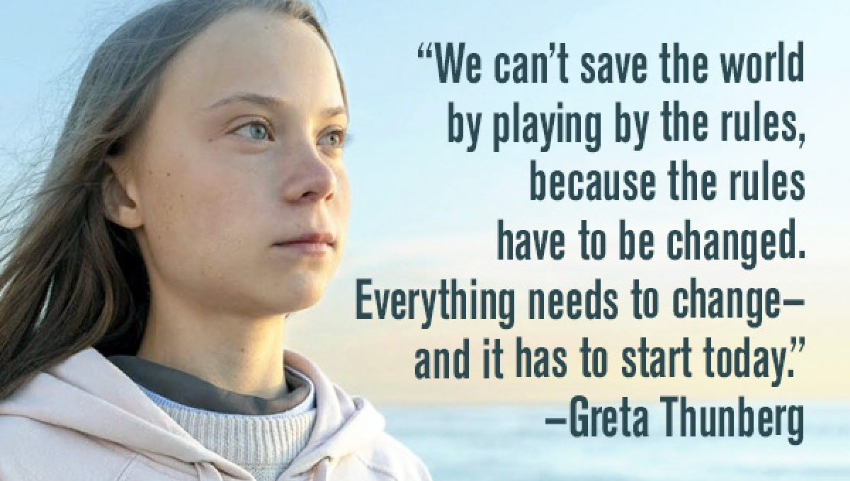

Slide 15

ACTIVITY: Make a pledge!
Email your pledge at esg@sonnedix.com

Slide 16

Thank you for playing your part to fight climate change!
Do you want to know more? If so, find more resources about climate change, solar and other topics related to sustainable development at Sonnedix Sustainability Academy:
www.sonnedix.com/sustainability-academy

